Slide 1
EFFICIENT INTRUSION DETECTION SYSTEM USING HYBRID ENSEMBLE MODEL FOR CLOUD COMPUTING
Team no : 09
PROJECT GUIDE : Dr. S BOSE
Team Members :
Araventh M - 2019103508
Gangaraju Tharun - 2019103520
Sourabh Sonny - 2019103064
Raj Kumar J - 2019103564

Slide 2
INTRODUCTION
An intrusion detection system (IDS) is a monitoring tool that keeps track of suspicious activity and sends out warnings when it finds something suspicious.
To address this issue, machine learning algorithms are increasingly being used in IDSs to improve their accuracy and reduce false positives.
The proposed hybrid IDS uses a combination of supervised algorithms such as decision tree, LSTM for intrusion detection.
The IDS is evaluated using the CICIDS2017 dataset and the results indicate that the proposed IDS is able to detect intrusions with a high degree of accuracy.

Slide 3
OVERALL OBJECTIVE
The main objective of an intrusion detection system (IDS) using ensemble algorithms in a cloud environment is to detect and prevent cybersecurity threats.
An IDS with ensemble algorithms continuously monitors the network traffic in the cloud environment in real-time to detect any anomalies or suspicious activities.
The ensemble algorithms analyze large volumes of data to identify patterns and detect potential threats before they can cause harm to the system or network.
Once a threat is detected, the IDS can respond quickly to prevent the threat from spreading or causing further damage.

Slide 4
Cloud-based IDS using ensemble algorithms can easily scale to handle large volumes of data and multiple locations, providing a comprehensive view of the network.
By detecting and preventing cybersecurity threats, the IDS helps to minimize the risk of data breaches, financial loss, and reputational damage to the organization.
Overall, the objective of an IDS using ensemble algorithms in a cloud environment is to provide a proactive approach to cybersecurity, identifying and preventing threats before they cause significant harm to the system or network.

Slide 5
LITERATURE SURVEY
Ref. no | Paper Title, Authors,Year, Journal name,Vol, Issue & pp | Methodology/ Technique/ Algorithm Used | Advantages | Issues / Gaps / Limitations | Ideas for adoption
1. | W. Wang, X. Du, D. Shan, R. Qin and N. Wang, "Cloud Intrusion Detection Method Based on Stacked Contractive Auto-Encoder and Support Vector Machine," in IEEE Transactions on Cloud Computing, vol. 10, no. 3, pp. 1634-1646, 1 July-Sept. 2022. | Support vector Machine | SACE (feature extraction) | Cannot efficiently detect unknown attacks | Feature Extraction (SCAE)

Slide 6
Ref. no | Paper Title, Authors,Year, Journal name,Vol, Issue & pp | Methodology/ Technique/ Algorithm Used | Advantages | Issues / Gaps / Limitations | Ideas for adoption
2. | A. M. Vartouni, S. S. Kashi and M. Teshnehlab, "An anomaly detection method to detect web attacks using Stacked Auto-Encoder," 2018 6th Iranian Joint Congress on Fuzzy and Intelligent Systems (CFIS), 2018, pp. 131-134. | Isolation forest | Detection of unknown attacks | High false alarm rate | Auto Encoder model
3. | A. Javadpour, S. Kazemi Abharian and G. Wang, "Feature Selection and Intrusion Detection in Cloud Environment Based on Machine Learning Algorithms," 2017 IEEE International Symposium on Parallel and Distributed Processing with Applications and 2017 IEEE International Conference on Ubiquitous Computing and Communications (ISPA/IUCC), Guangzhou, China, 2017, pp. 1417-1421F | Neural Network, Fuzzy Logic | Suitable for Qualitative features | Low Flexibility | Decision Tree Model

Slide 7
Ref. no | Paper Title, Authors,Year, Journal name,Vol, Issue & pp | Methodology/ Technique/ Algorithm Used | Advantages | Issues / Gaps / Limitations | Ideas for adoption
4. | G. Kene and D. P. Theng, "A review on intrusion detection techniques for cloud computing and security challenges," 2015 2nd International Conference on Electronics and Communication Systems (ICECS), Coimbatore, India, 2015, pp. 227-232 | Hybrid based detection | Accurate detection of known attacks | Can’t detect unknown attacks | Different types of Attack generation
5. | M. Ficco, L. Tasquier and R. Aversa, "Intrusion Detection in Cloud Computing," 2013 Eighth International Conference on P2P, Parallel, Grid, Cloud and Internet Computing, Compiegne, France, 2013, pp. 276-283 | Artificial Neural Network | Central correlation system to send alerts | Less Accuracy | IDS cloud Architecture

Slide 8
Ref. no | Paper Title, Authors,Year, Journal name,Vol, Issue & pp | Methodology/ Technique/ Algorithm Used | Advantages | Issues / Gaps / Limitations | Ideas for adoption
6. | U. Oktay and O. K. Sahingoz, "Proxy Network Intrusion Detection System for cloud computing," 2013 The International Conference on Technological Advances in Electrical, Electronics and Computer Engineering (TAEECE), Konya, Turkey, 2013, pp. 98-104 | Deep learning algorithms | Better at hardware usage | Time taking | Anomaly based IDS
7. | A. Kannan, G. Q. Maguire Jr., A. Sharma and P. Schoo, "Genetic Algorithm Based Feature Selection Algorithm for Effective Intrusion Detection in Cloud Networks," 2012 IEEE 12th International Conference on Data Mining Workshops, 2012, pp. 416-423. | Genetic Feature Selection | Low false alarm rate | Features are removed without any extractions. | Genetic Algorithm model

Slide 9
Ref. no | Paper Title, Authors,Year, Journal name,Vol, Issue & pp | Methodology/ Technique/ Algorithm Used | Advantages | Issues / Gaps / Limitations | Ideas for adoption
8. | H. A. Kholidy and F. Baiardi, "CIDS: A Framework for Intrusion Detection in Cloud Systems," 2012 Ninth International Conference on Information Technology - New Generations, Las Vegas, NV, USA, 2012, pp. 379-385 | P2P Network Architecture | Flexibility and Scalability | Not sufficient for detecting large scale attacks | Storage of new attack in database
9. | F. I. Shiri, B. Shanmugam and N. B. Idris, "A parallel technique for improving the performance of signature-based network intrusion detection system," 2011 IEEE 3rd International Conference on Communication Software and Networks, 2011, pp. 692-696. | Parallel Processing | Reduce Process Time | Cannot detect unknown attacks | Signature based Intrusion Detection System

Slide 10
Ref. no | Paper Title, Authors,Year, Journal name,Vol, Issue & pp | Methodology/ Technique/ Algorithm Used | Advantages | Issues / Gaps / Limitations | Ideas for adoption
10. | C. -C. Lo, C. -C. Huang and J. Ku, "A Cooperative Intrusion Detection System Framework for Cloud Computing Networks," 2010 39th International Conference on Parallel Processing Workshops, San Diego, CA, USA, 2010, pp. 280-284 | Majority Vote Method | Better accuracy | Less number of attacks detected | Threshold check and Alert System

Slide 11
SUMMARY OF ISSUES:
As the number of cloud services and users increases, the amount of data to be analyzed also increases, making it difficult for traditional intrusion detection systems to handle.
The data is not created and the utilised datasets are out of date.
Not detecting the unknown attacks and also having less accuracy
The accuracy of the system in detecting and classifying attacks is low. False positives (i.e., classifying benign traffic as malicious) and false negatives (i.e., failing to detect actual attacks) can result in wasted resources and missed opportunities to prevent attacks.

Slide 12
Proposed System
Used Weighted average ensemble model by combining decision tree and LSTM model by generating weights using genetic algorithm
Signature based detection by storing new attacks
Feature selection and hyper parameter tuning using double particle swarm optimization algorithm

Slide 13
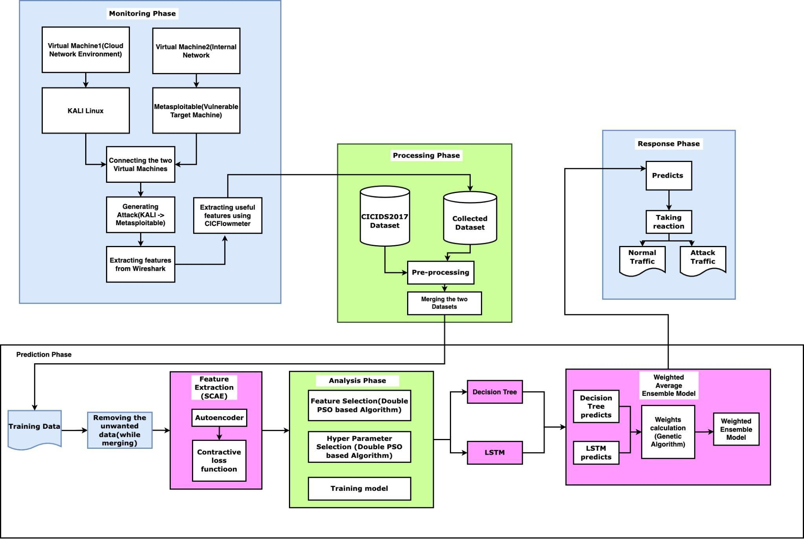
Overall Architecture

Slide 14
EXPERIMENTAL SETUP
Azure Virtual Machines
CIC Flowmeter
Google Colaboratory
Numpy
Tensorflow
Scipy
Genetic algorithm
Seaborn
Keras

Slide 15
DETAILS OF MODULE DESIGN
List of Modules:
Monitoring Phase
Processing Phase
Analysis Phase
Prediction Phase
Response Phase

Slide 16
MONITORING PHASE:
The monitoring module's initial job is to capture all in-bound and out-bound data packets transiting the cloud network.
The monitoring module employs sensors to sensitive network traffic to help in this operation.
Furthermore, the monitoring module may collect data packets from various application, transport, and network protocols such as TCP, UDP, ICMP, IP, HTTP, SMTP, and so on.
Here, this is done by generating the normal and attack traffic using kali linux tools from Kali Linux to Metasploitable (Vulnerable Target Machine) and these packets are captured by using wireshark and collected the useful features by placing CICFlowmeter in Host Virtual Machine.

Slide 17
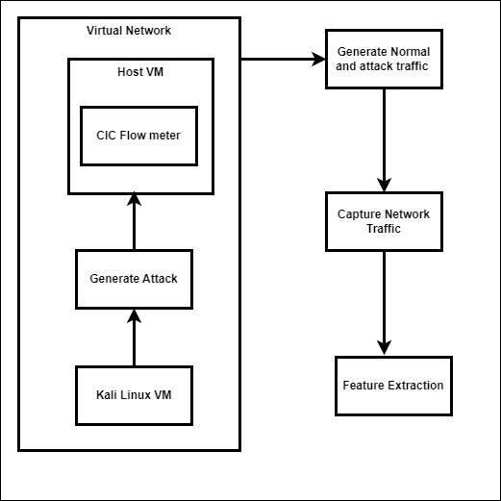
Fig 5.1 describes the capturing of real-time traffic in the virtual machine set in azure environment, in which attack is stimulated from a Kali-Linux on the host machine and captured using CIC Flowmeter where 32 features are captured.
Fig 5.1 MONITORING PHASE

Slide 18
Output: Data packets of real-time traffic
Steps:
Private Cloud is set with multiple Virtual Machine.
One Virtual Machine, say Kali Linux is used to generate different attack on the host machine.
CIC Flow meter is used in Host VM to capture the network traffic and export the data as CSV.
Feature Extraction is to be performed in the exported data.

Slide 19
PROCESSING PHASE:
It initially gets data records from the Monitoring phase and attempts to merge with already existing data that is CICIDS2017.
After this the both collected data and the existing data will go into the pre-processing where the Nan and infinite values are removed, Numeralization and Normalization will take place.
These collected data is preprocessed in such a way that it can be fed to the SCAE model for feature extraction.

Slide 20
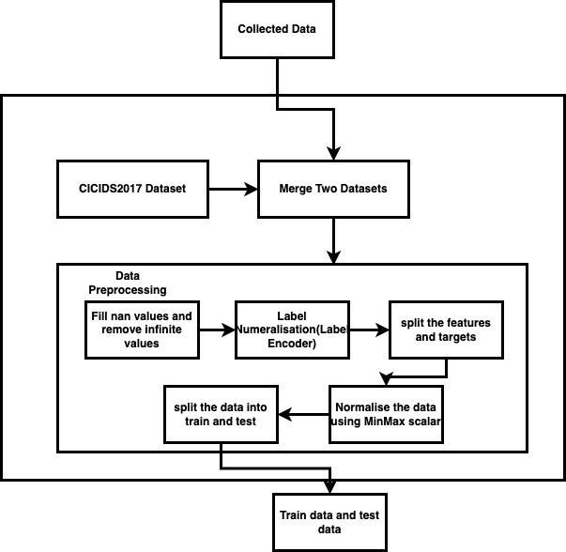
In Fig 5.2 the processing module completes all necessary missions, prior to the forecast procedure.
Fig 5.2 PROCESSING PHASE

Slide 21
Input: Collected Data Packets
Output: Preprocessed data
Algorithm:
Remove Nan values and infinite values
Using label encoder fit the labels and transform it into numbers
Split the features and targets
Use normalizer as Min Max scaler
xi = (xi - min) / (max - min).
Split the data into train and test.

Slide 22
PREDICTION PHASE:
The data collected from the processing module will go through the feature extraction algorithm (SCAE) and produce an output dataset, which will be used as the input dataset to Feature Selection and Hyper parameter selection in Analysis phase and this phase will receive the data form analysis phase and that data, collected hyper parameters are used to train the model.
The created model performs two sequential tasks, which is the core of the proposed CIDS. The first step is to build the weighted average ensemble system utilizing the previously trained decision tree and LSTM models, where the weights for that ensemble model will be generated by the fitness function of the genetic algorithm.
The prediction module's second purpose is to successively choose a data record from the preprocessed, unseen database. Following that, the selected data record is tested using the ensemble system, and the weighted ensemble engine's final judgment is sent to the response module.

Slide 23
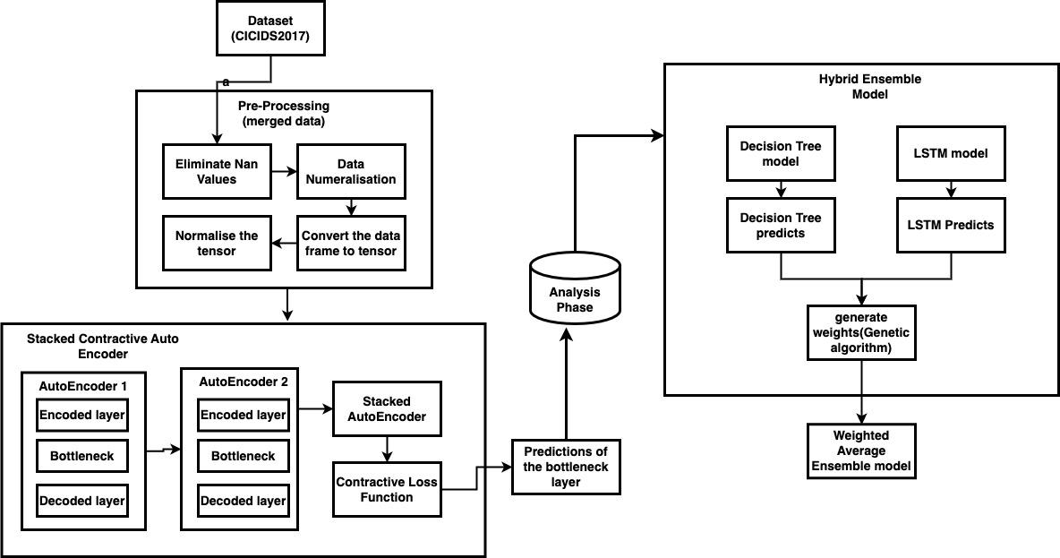
In Fig 5.4 the prediction module collects the data from the processing module and checks whether there are any vulnerabilities while merging and resolve them.
Fig 5.3 PREDICTION PHASE

Slide 24
First of all, convert the dataset from unbalanced to balanced label encoding, and then normalization is needed. The mini-max transformation is used for normalization,
xi = (xi - min) / (max - min).
Input: Dataset from Processing phase
Output: Feature Extracted data (32 features)
Algorithm-SCAE:
Define hyper parameters like learning rate, coefficient of contractive penalty term (beta)
Define layers of the autoencoder and stack them on each other
Define a contractive loss function where,
Calculate jacobian matrix and compute each partial derivative and form a matrix

Slide 25

b. Calculate Forbenius norm where it is the root of sum of squares of each element in jacobian matrix.
c. Calculate the contractive penalty
reduce_mean(forbenius_norm)
d. Return loss output as
4. Compile the model with loss as mean squared error as primary loss and contractive loss as the secondary loss
5. Get the predictions by testing the test data and train data with the model.

Slide 26
Input: Feature Selected data from Analysis phase(24 features) and hyper parameters
Output: Trained Ensemble Model
Algorithm - Weighted Average Ensemble method:
Create Genetic algorithm with 100 iterations to find weights in order to get good accuracy
Define weight bounds
b. Define fitness function
c. Find accuracy for weight_pred
Accuracy = (TP + TN) / (TP + FP + TN + FN)
d. Repeat b and c until 100 iterations.
By considering weights from step 1, find the accuracy with the test labels and weight preds.

Slide 27
ANALYSIS PHASE
The analysis module runs the double PSO-based method for feature and hyper parameter selection during the pre-training phase.
After data preparation, the analysis module obtains a copy of the main database.
The upper level of the double PSO-based method is then executed on the main database to determine the best feature subset.
The main database is then reduced using only the best characteristics.
Then, using the decreased master database, it conducts the bottom level of the double PSO-based method to generate the ideal hyper parameter vector.

Slide 28
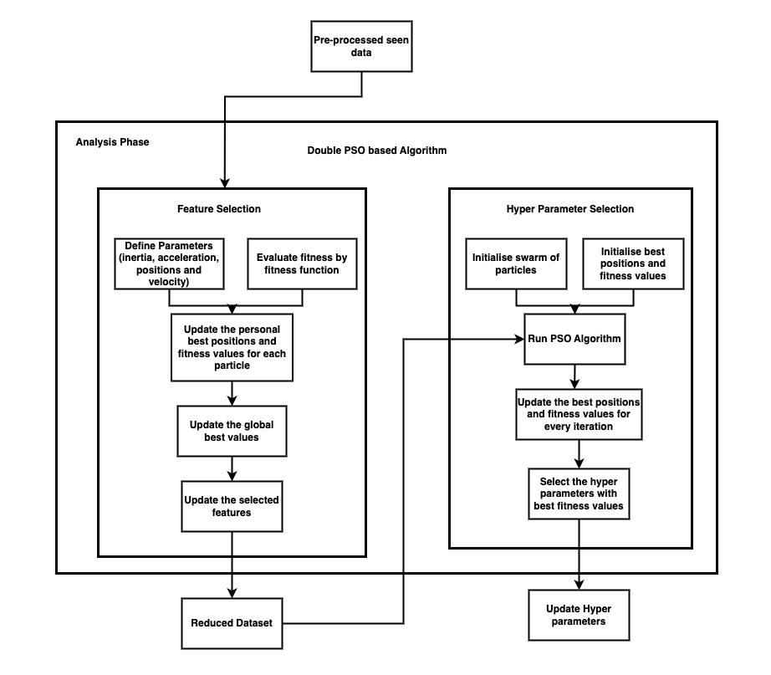
In Fig 5.3 the analysis module handles the deep learning models pre-training and training stages.
Fig 5.4 ANALYSIS PHASE

Slide 29
Input: Dataset of 32 features (from SCAE)
Output: Reduced dataset (Features)
Algorithm - Particle Swarm Optimization Upper Level:
Initialize PSO parameters
Evaluate the fitness of each particle based on the corresponding feature subset
Update personnel best positions and fitness values for each iteration
Update global best positions and fitness values for the swarm.
Update the velocities and positions of the particle.
V_{i} = w * v _{i} + c1 *rand() * (pbest_{xi} - x _{i}) + c2 * rand() * (gbest _{x} - x _{i})
x _{i} = x _{i} + v _{i}
Repeat 2 to 5 until maximum iterations reached
Select the feature subset corresponding to the global best position.

Slide 30
Input: Reduced data
Output: Best hyper parameters for executing the model
Algorithm - Particle Swarm Optimization Lower Level:
Define parameters for PSO
Initialize swarm particles with randomly using search space
Evaluate Fitness of each particle
Update personnel best positions and fitness values for each iteration
Update global best positions and fitness values for the swarm
Update Velocity and position of each particle
Calculate Inertia weight
w _{i} = w _{start} - (w _{end} - w _{start}) * (iter / max_iter)

Slide 31
b. Compute Cognitive coefficient
v _{i} = w _{i} * v _{i} + c1 * rand() * (pbest _{i} - x _{i})
c. Calculate social coefficient
v _{i} = w _{i} * v _{i} + c2 * rand() * (gbest - x _{i})
d. Calculate Cognitive component and Social component
Cognitive_component = cognitive_coeff * (part [‘personel_best_position’] - part [‘position’]
Social_component = social_coeff * (part [‘personel_best_position’] - part [‘position’]
e. Update the velocity and position of each particle
Part[‘velocity’] = Part[‘velocity’] * inertia_weight + Cognitive_component + Social_component

Slide 32
f. Update position of the particle by adding its velocity to its current position.
7. Repeat 3 to 6 until maximum iterations are done.
8. Select the hyper parameters with the best fitness as the optimal hyper parameter subset.

Slide 33
RESPONSE PHASE
This function is in charge of reacting to the final decision of "Normal" or "Attack".
In the instance of "Normal," the response module instructs the prediction module to go to the next data record in the unseen database in order to forecast its label.
If, on the other hand, the final choice obtained is "Attack," the response module issues an alert that the cloud network is being subjected to potentially harmful activities.
Input: Unlabeled data
Output: Type of Traffic

Slide 34
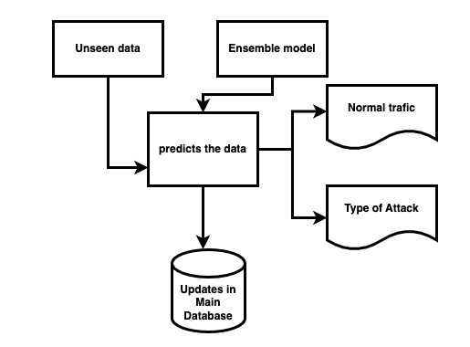
In Fig 5.5, the response module receives both the final model and the tested data record, and then labels the tested data record with the final model.
Fig 5.5 RESPONSE PHASE

Slide 35
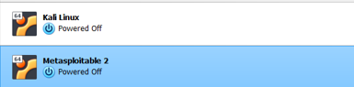
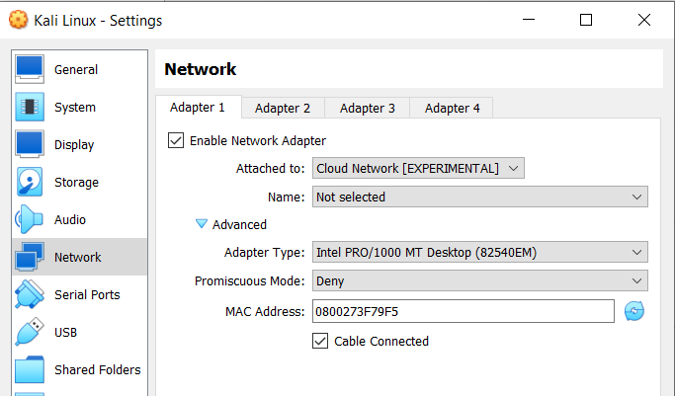
IMPLEMENTATION DETAILS 100%
Attack Data Collection:
Fig 6.1 shows the 2 VMs namely Kali Linux (an attacker machine) and Metasploitable 2 (a vulnerable linux machine for security and penetration testing purposes)
Fig 6.2(a) shows the network adapter 1 configuration Kali Linux

Slide 36
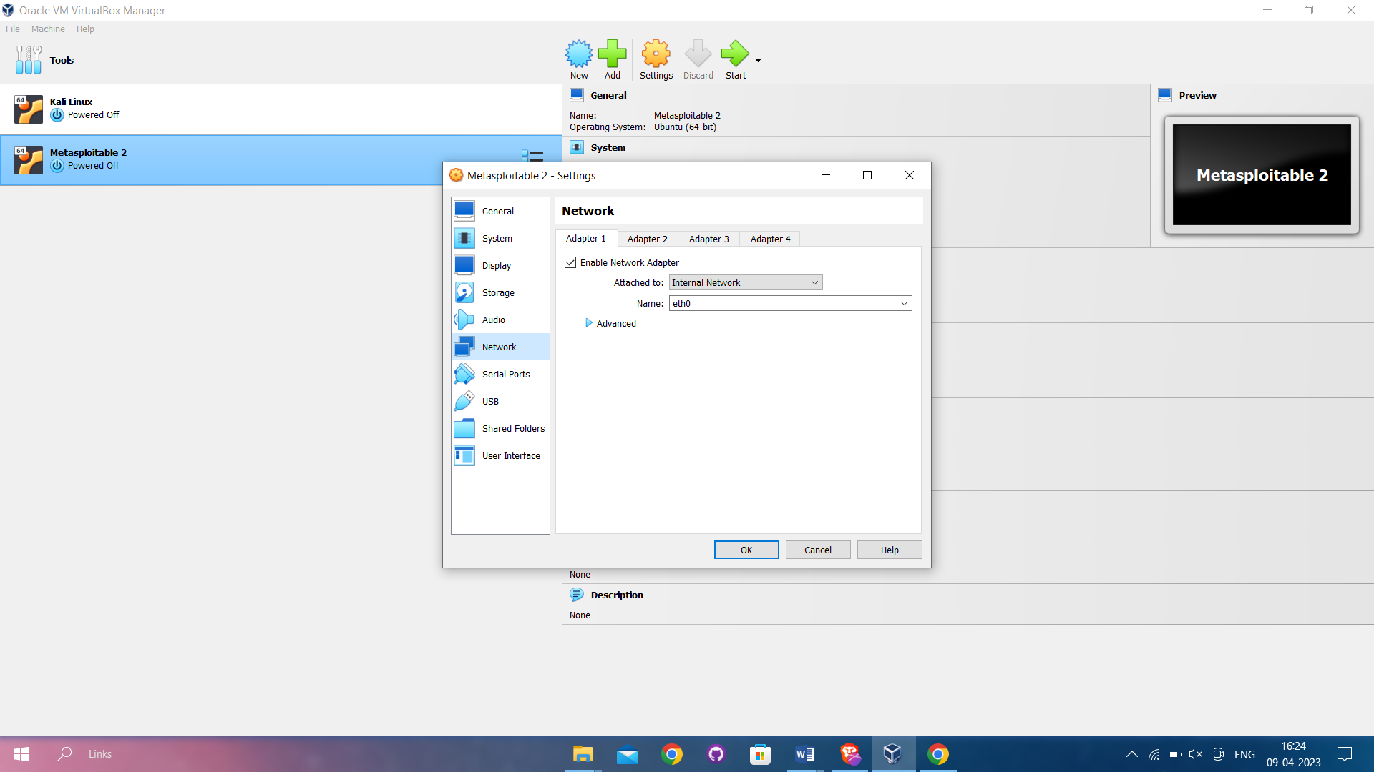
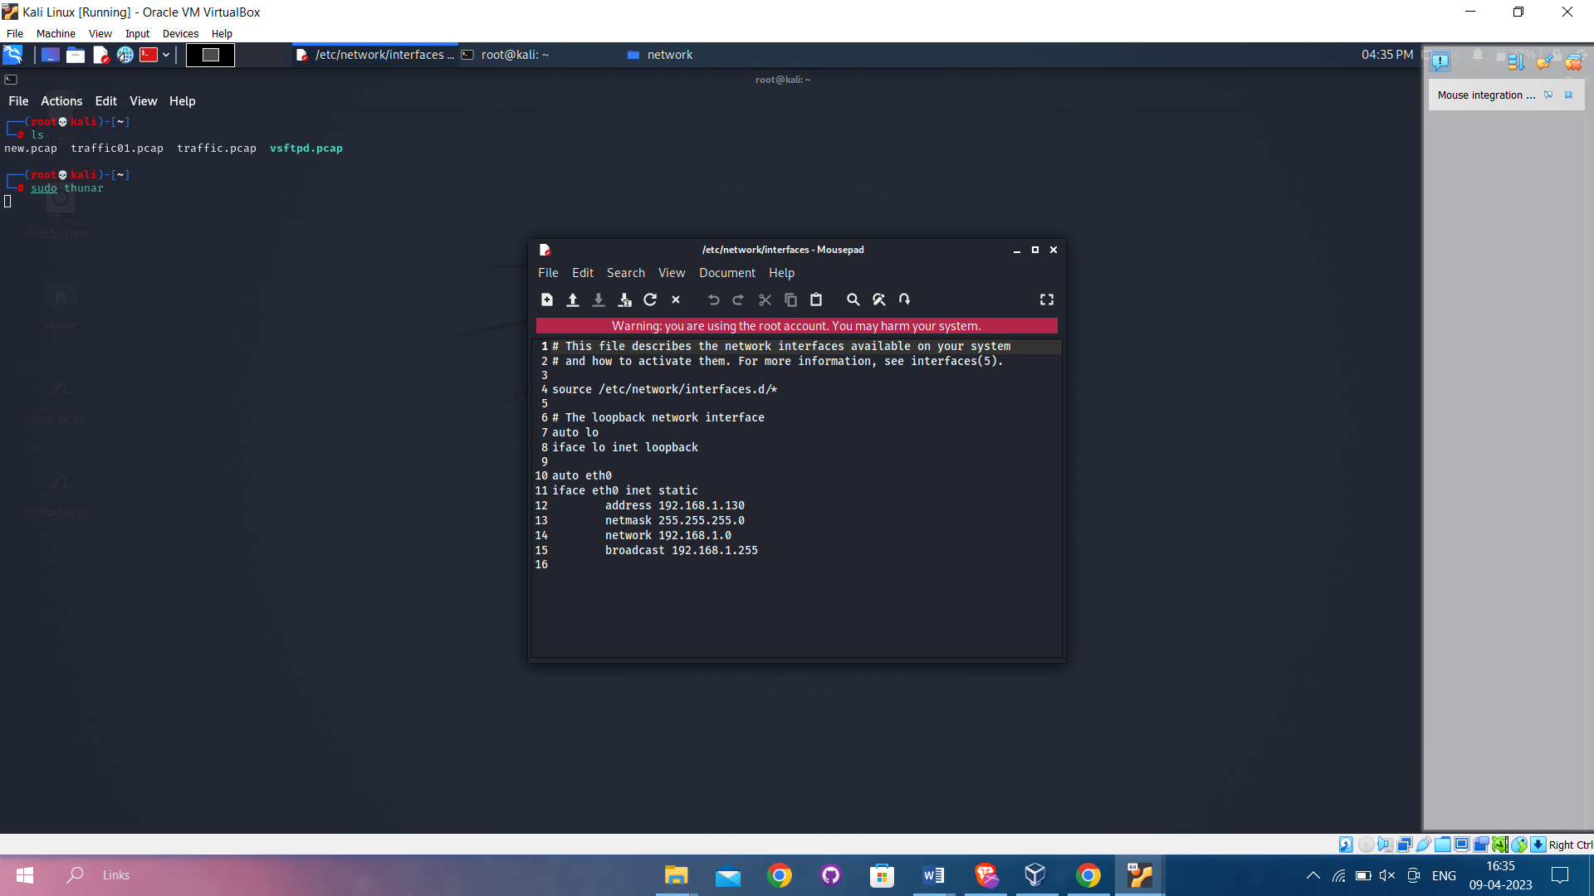
Fig 6.2(b) shows the network adapter 1 configuration Kali Linux
Fig 6.3 shows the network interface file code for sending and receiving packets in Kali Linux

Slide 37
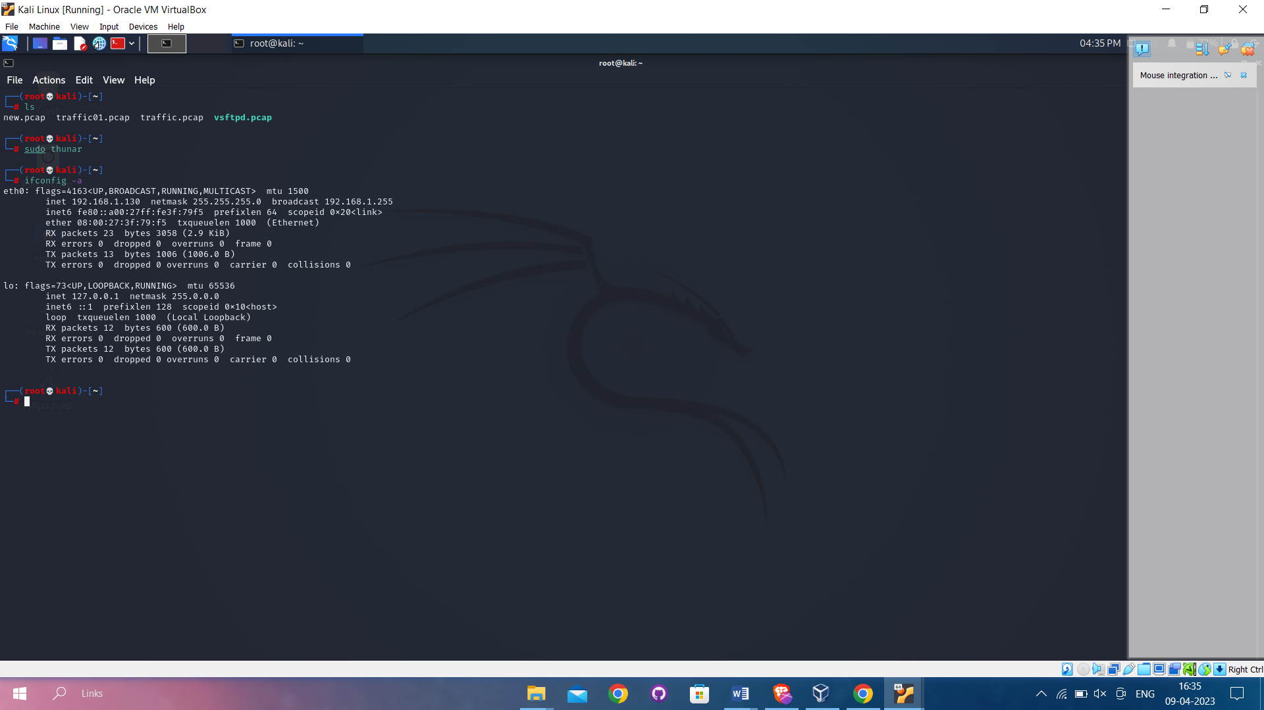
Fig 6.4 shows the network interface configuration in metasploitable-2 server

Slide 38
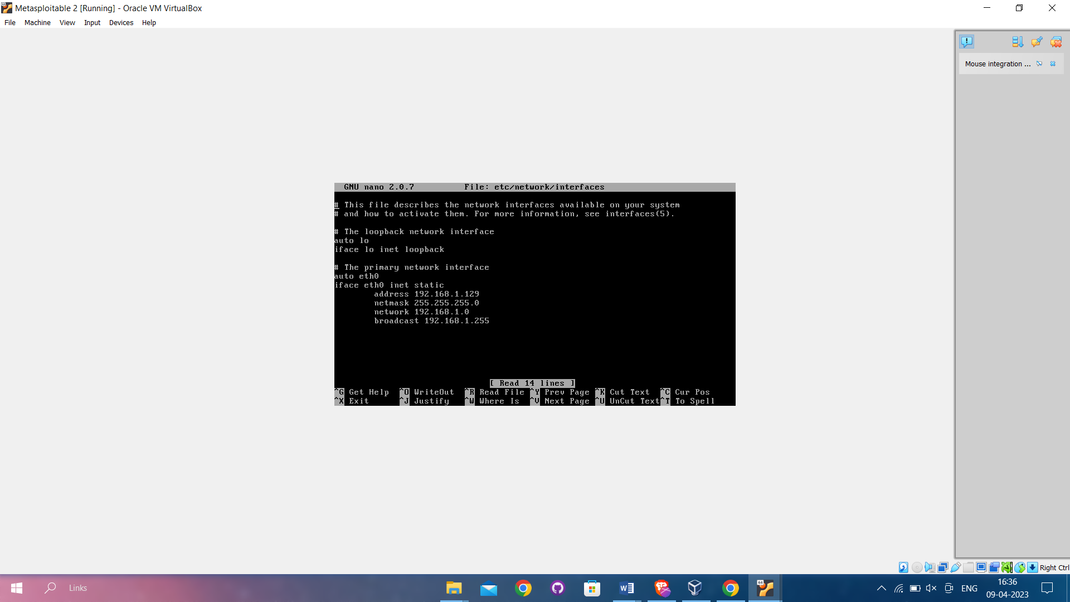
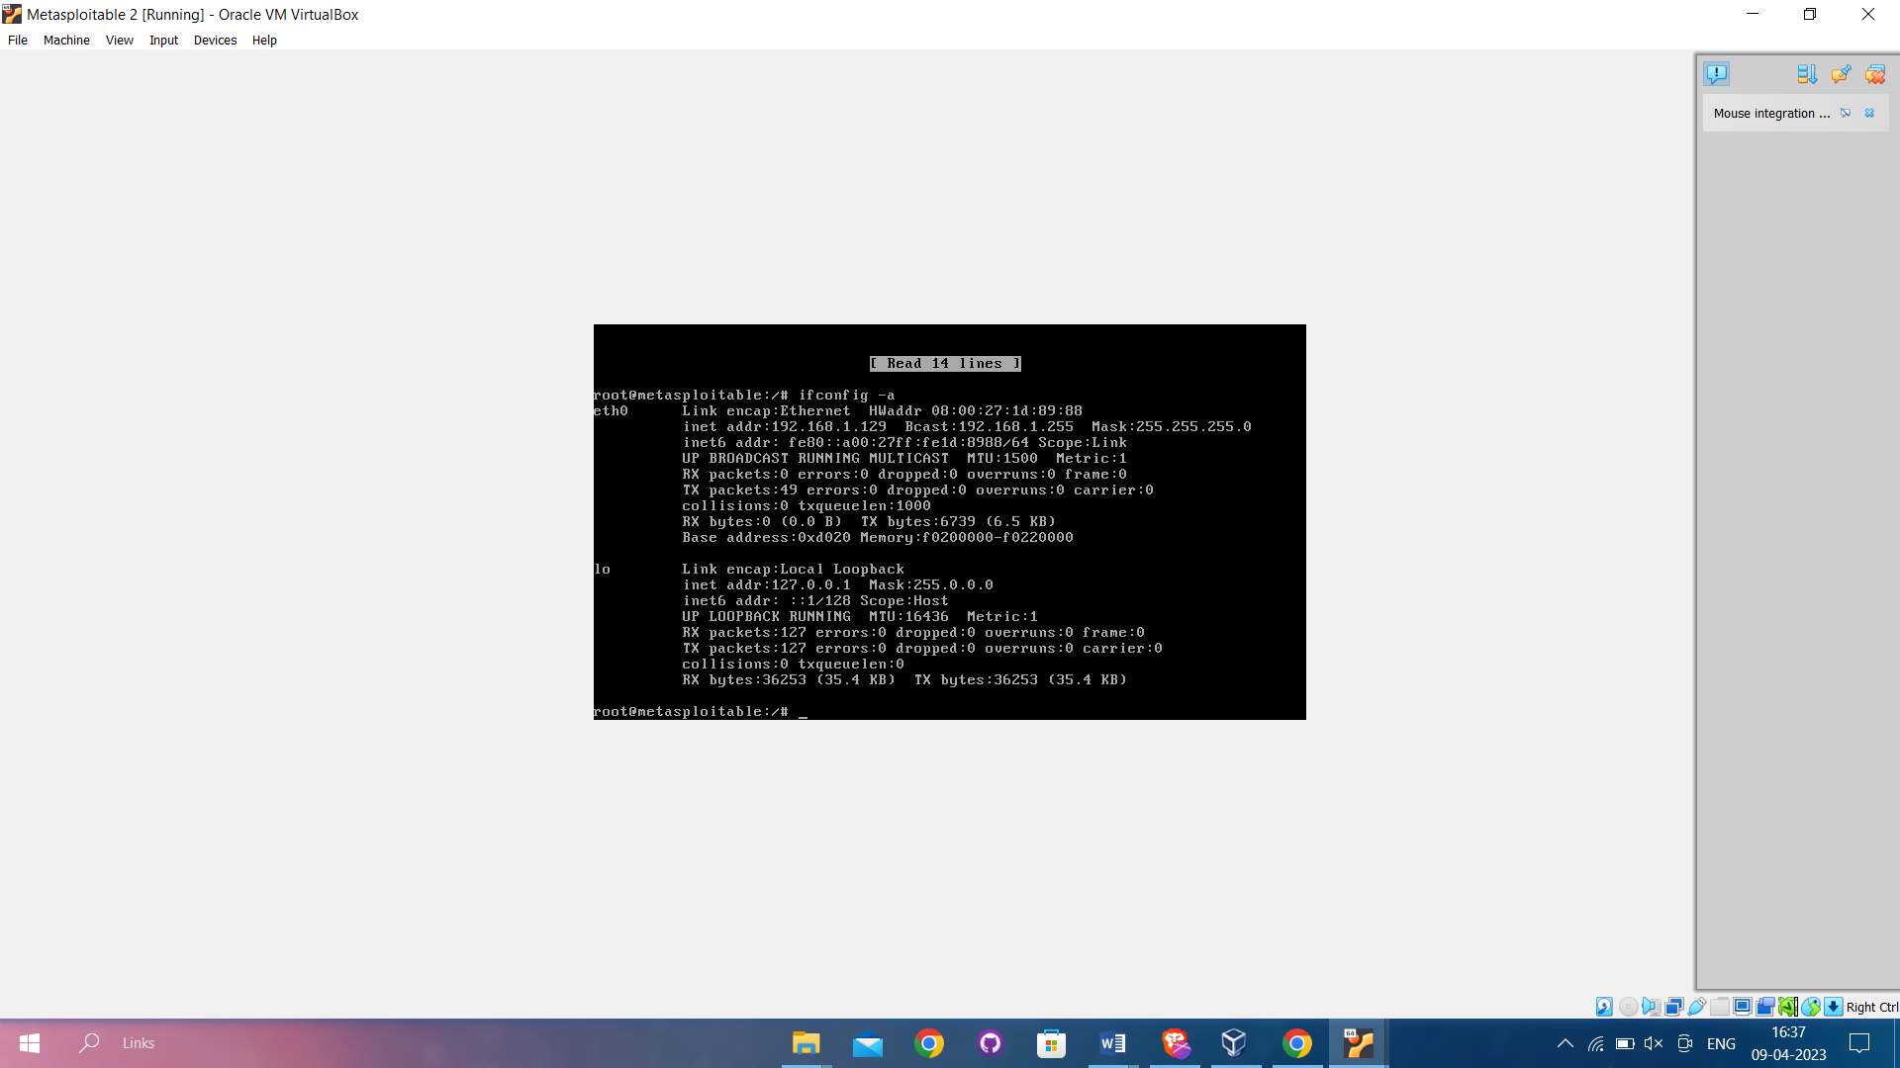
Fig 6.5 Shows the network interface file code for sending and receiving packets in metasploitable
Fig 6.6 Shows the network interface configuration in metasploitable-2

Slide 39
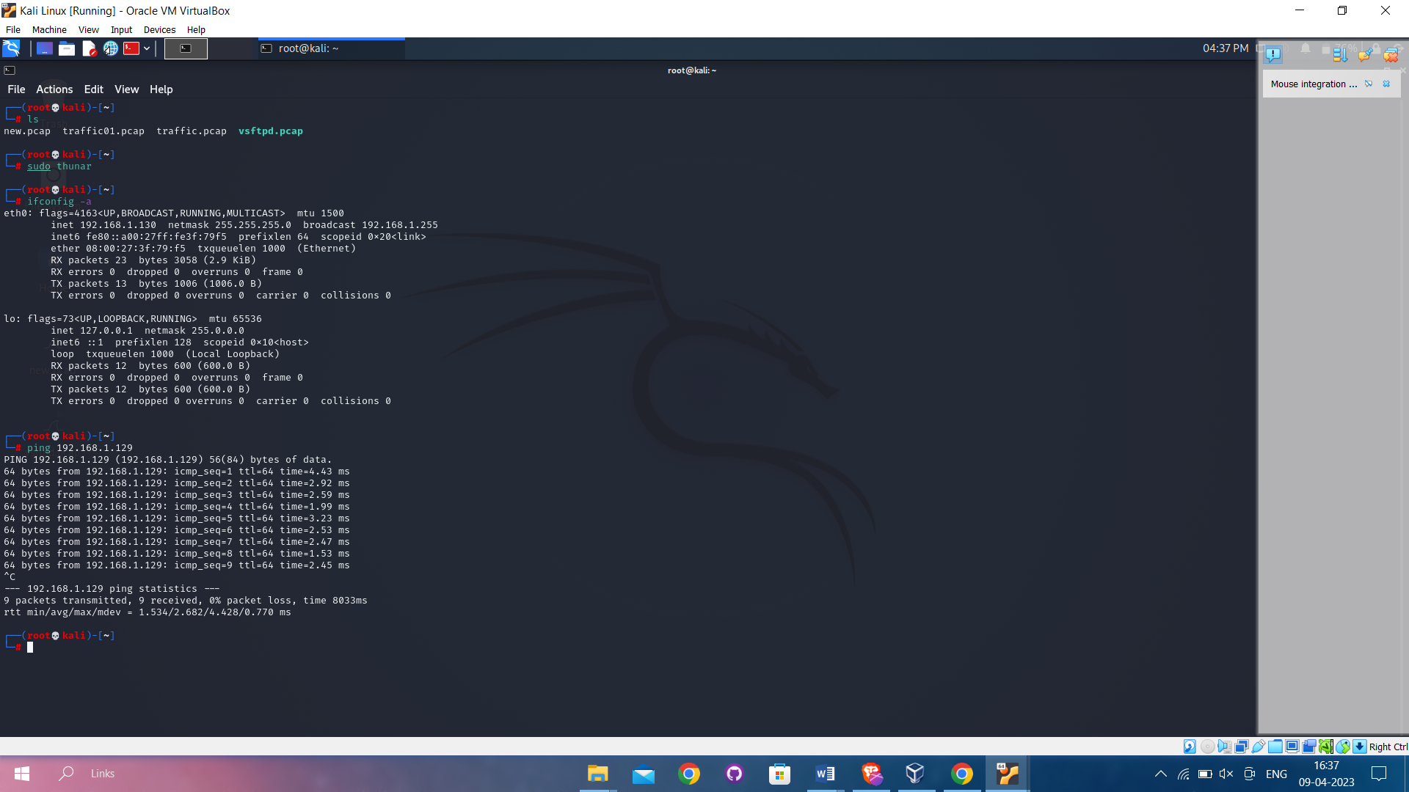
Fig 6.7 shows the network interface configuration in Kali Linux VM
Fig 6.8 shows the ping from Kali Linux VM to Metasploitable-2 VM

Slide 40
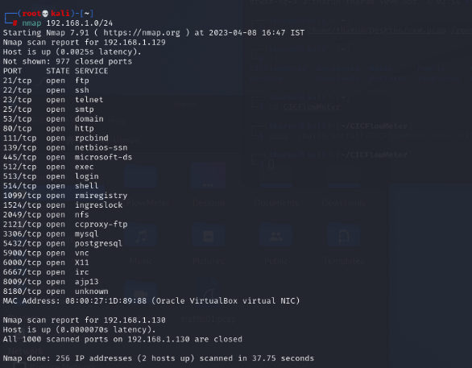
Fig 6.9 shows the nmap scanned report of the kali linux

Slide 41
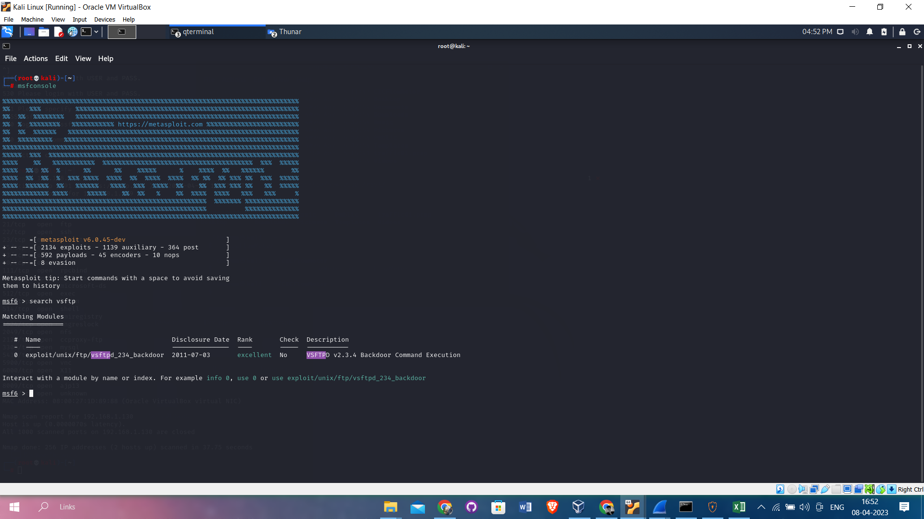
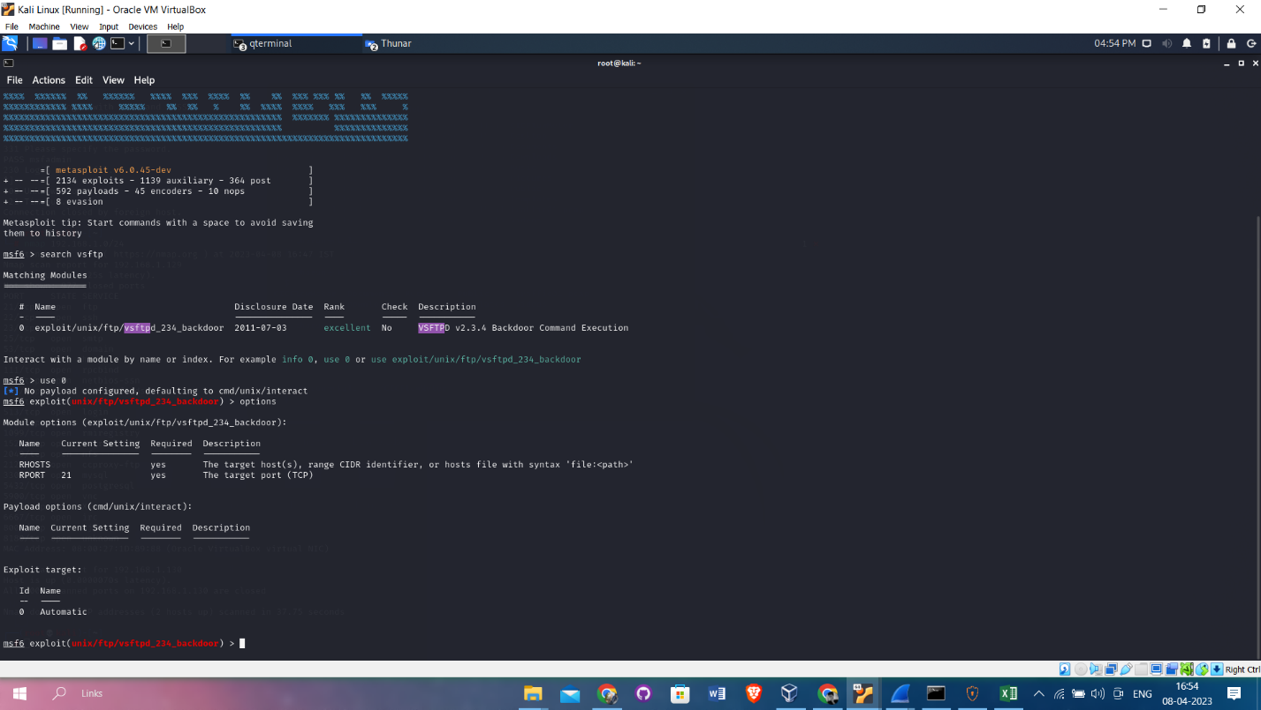
Fig 6.10
Fig 6.11

Slide 42
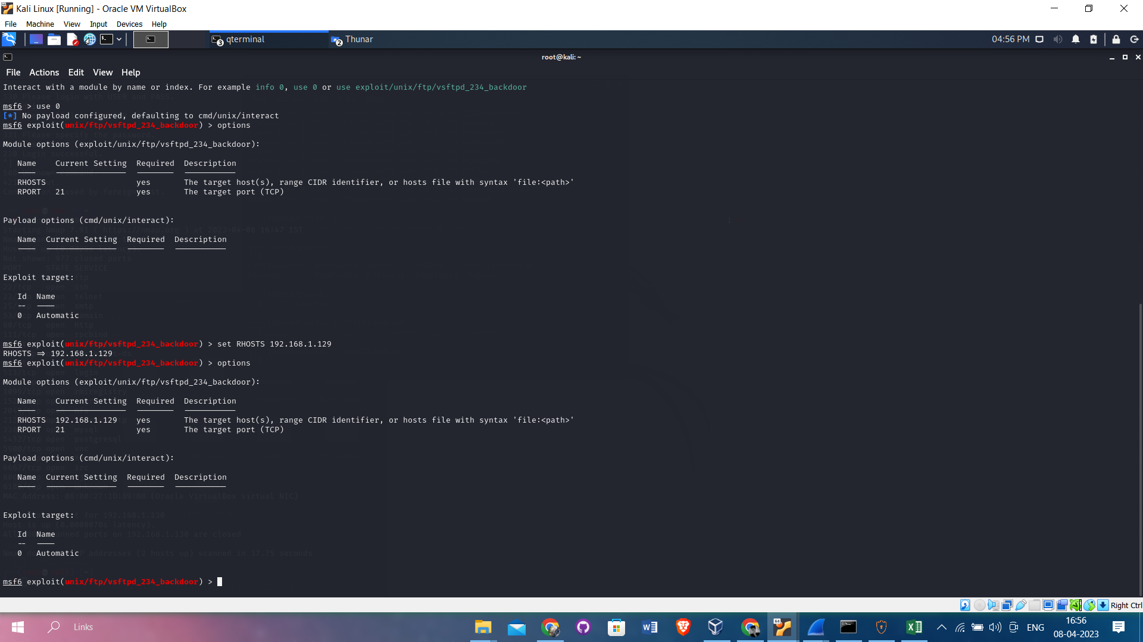
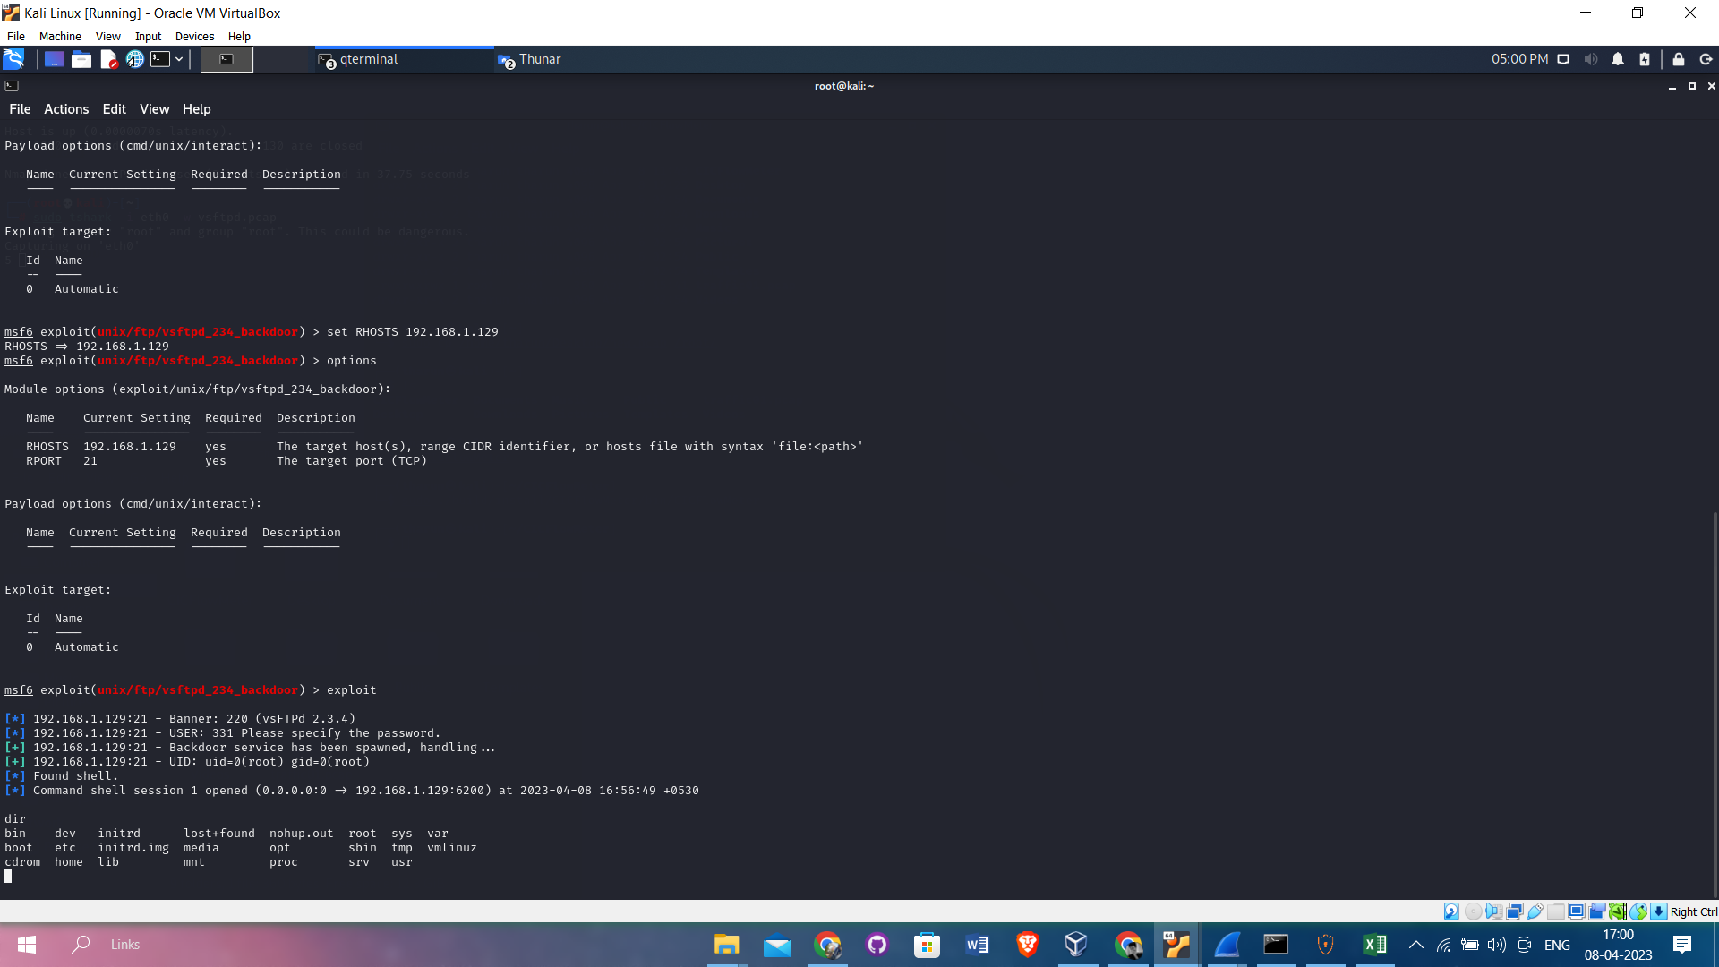
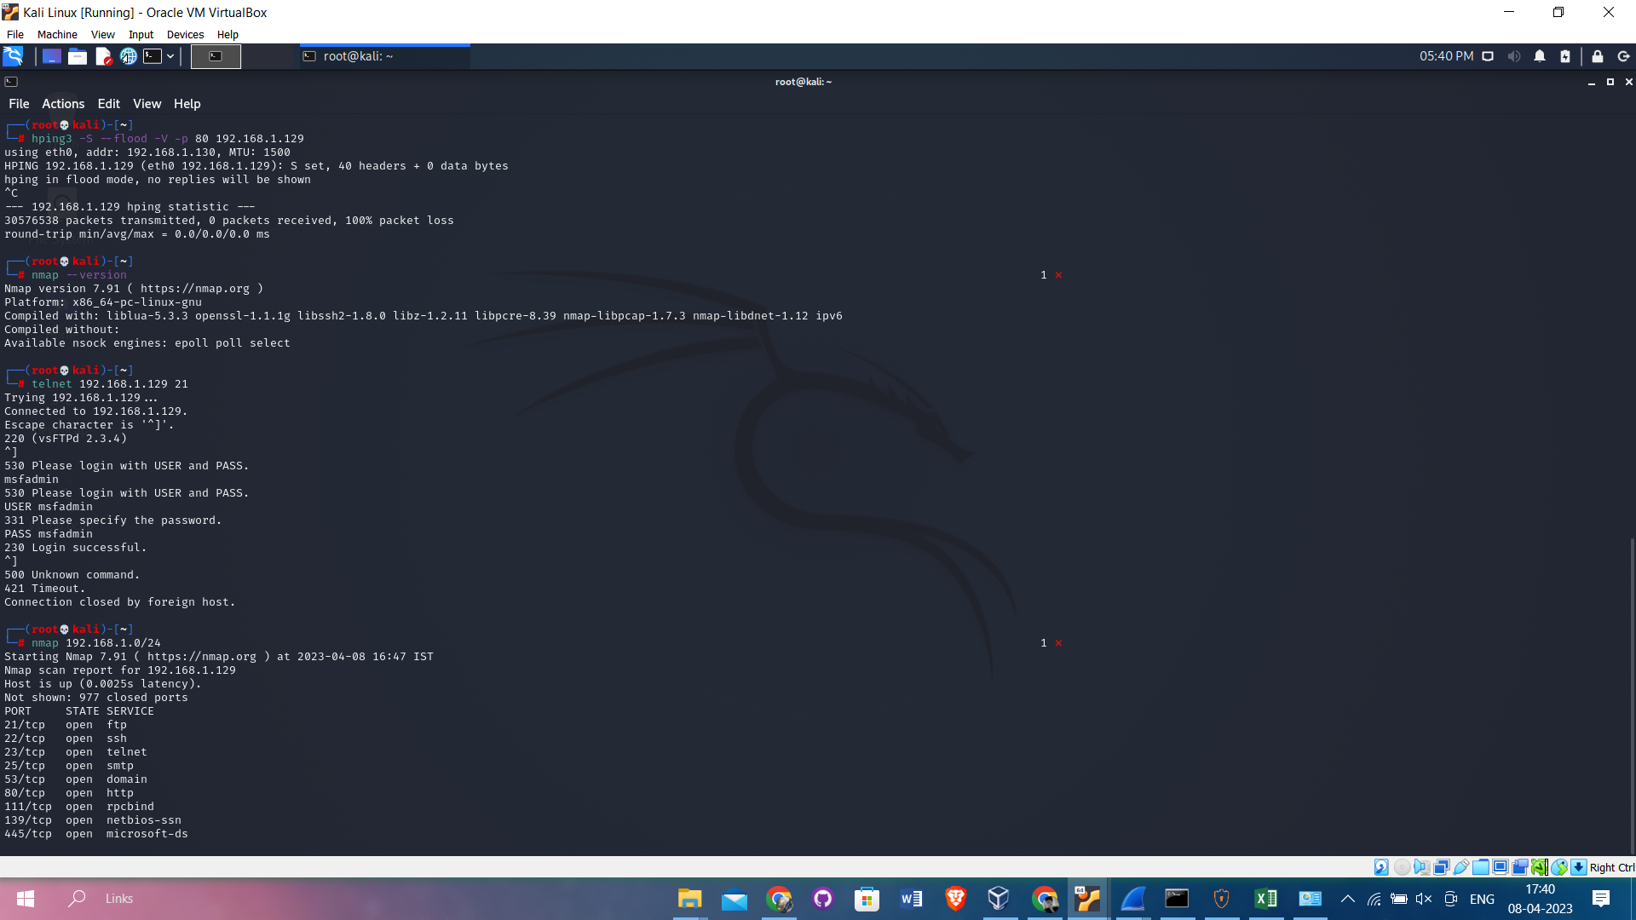
Fig 6.12 shows the options of IP addresses to attack
Fig 6.13 shows the exploitation of U2R attack as kali Linux user can use the Shell of Metasploitable
Fig 6.14 Shows the DOS attack generation using hping3 tool in Kali linux

Slide 43
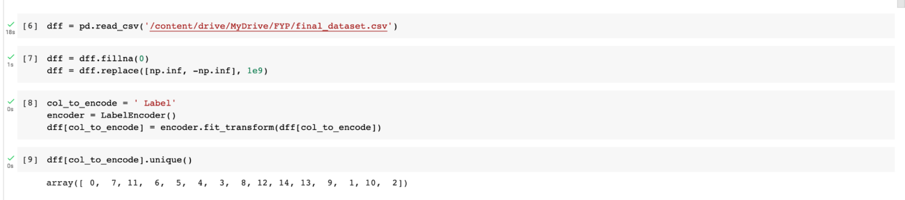
Pre-processing techniques:
LABEL ENCODING & REMOVING NAN AND INFINITE VALUES:

Slide 44
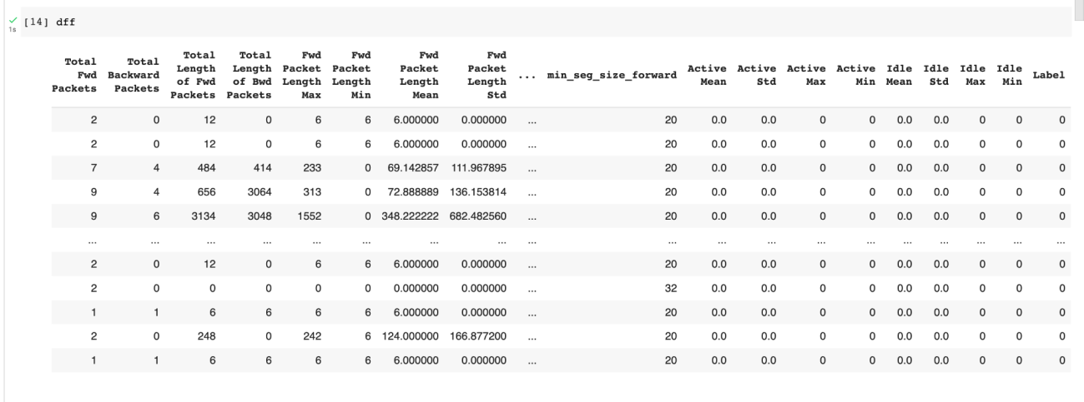
Fig 6.15 LABEL ENCODING - of CICIDS2017 Dataset

Slide 45
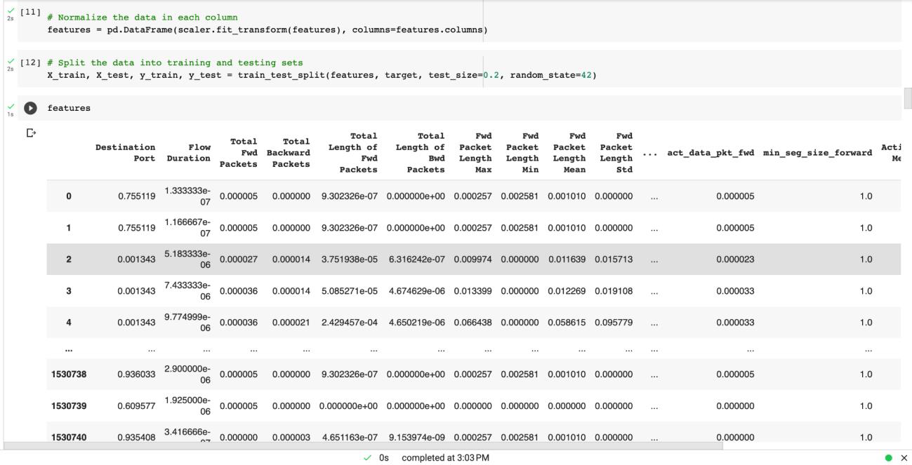
NORMALISATION (MIN MAX SCALAR)
Fig 6.16 MIN MAX SCALAR – depicts normalizing of dataset

Slide 46
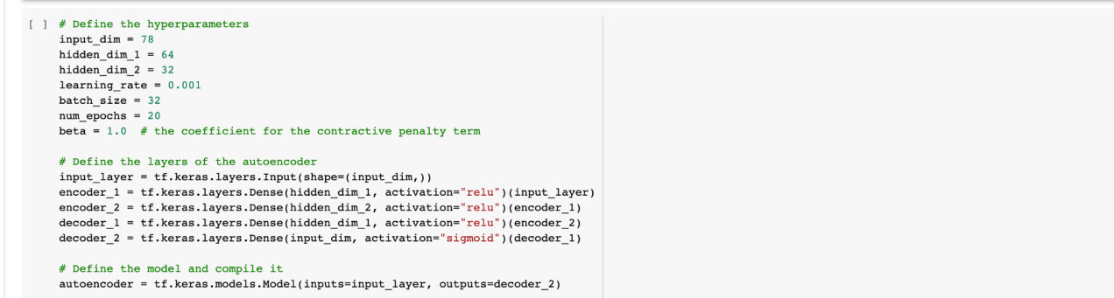
FEATURE EXTRACTION (SCAE):
Fig 6.17 AUTO ENCODER - creating the auto encoder layers

Slide 47
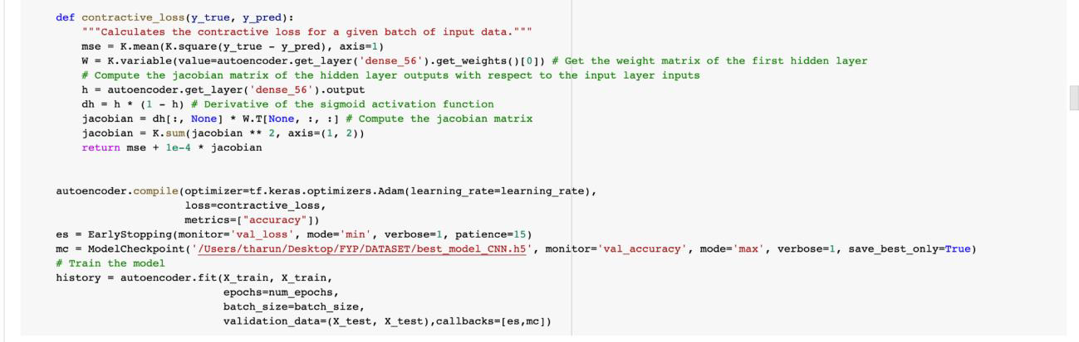
Fig 6.18 CONTRACTIVE LOSS FUNCTION – specifying the loss function

Slide 48
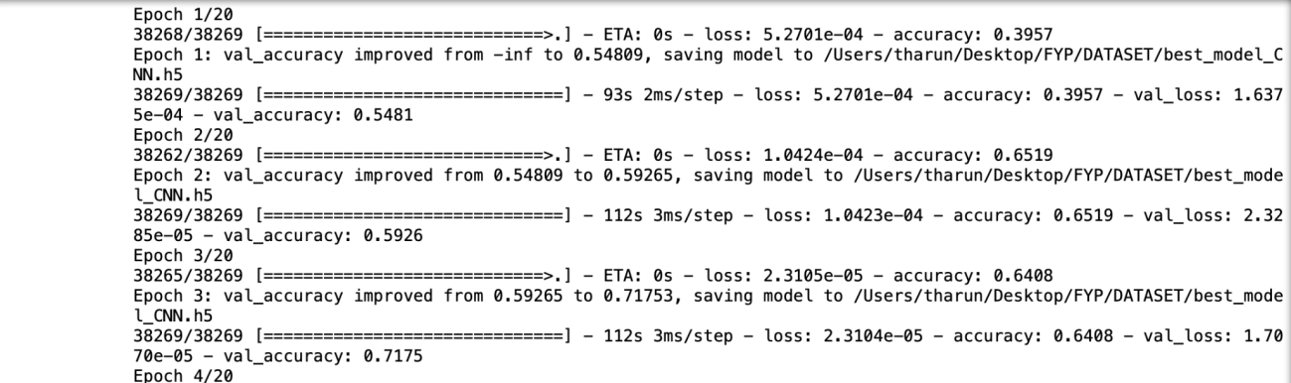
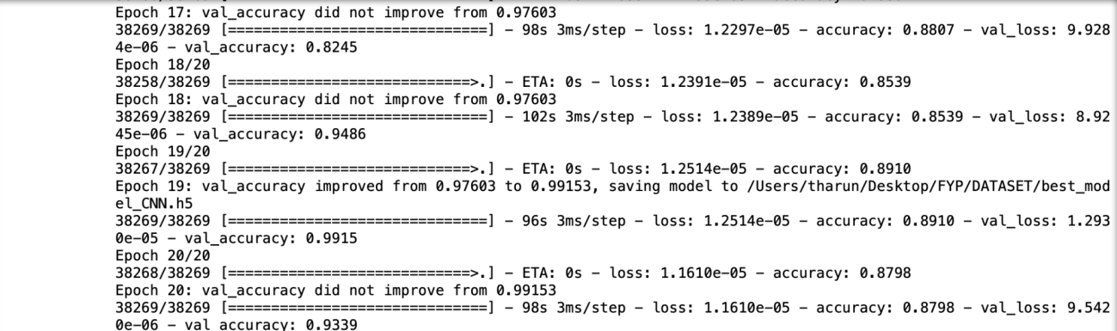
Fig 6.19 TRAINED SCAE - shows accuracy of each epoch during training

Slide 49
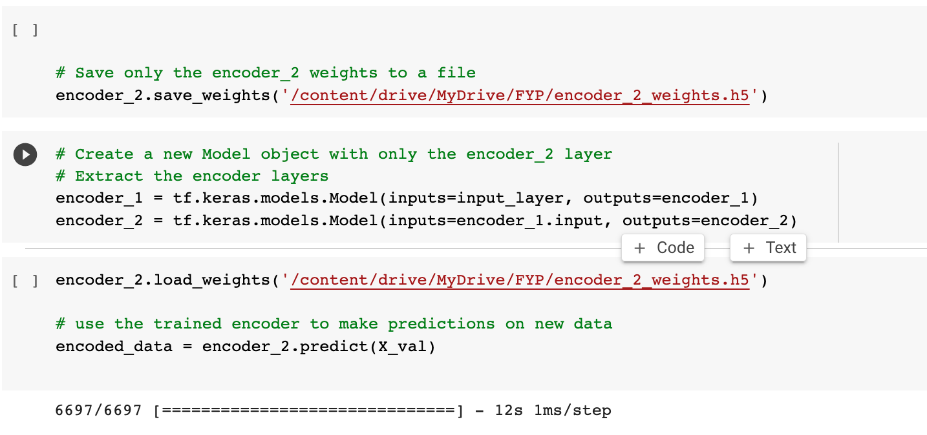
Fig 6.20 SAVING AND LOADING THE WEIGHTS– Lading the best weights for auto encoder

Slide 50
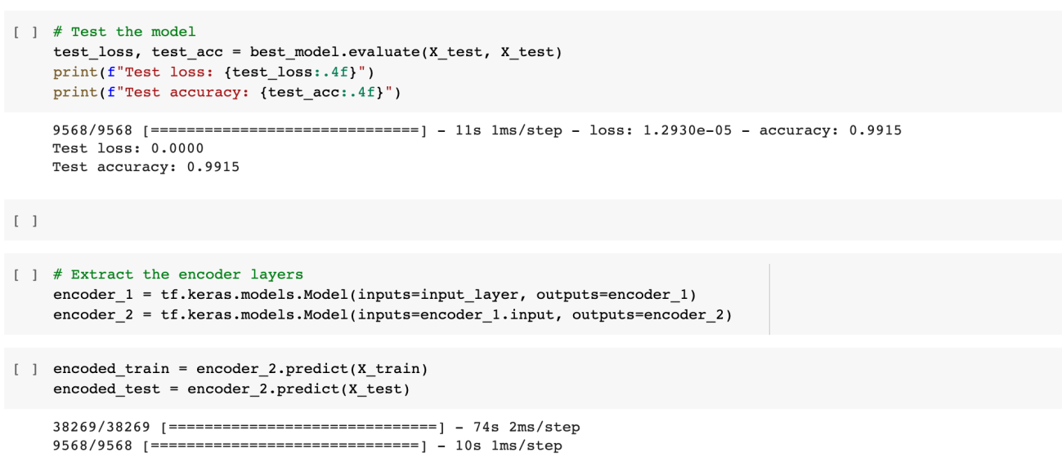
Fig 6.21 ACCURACY AND PREDICTIONS – shows testing accuracy and 32 features are extracted as output from data

Slide 51
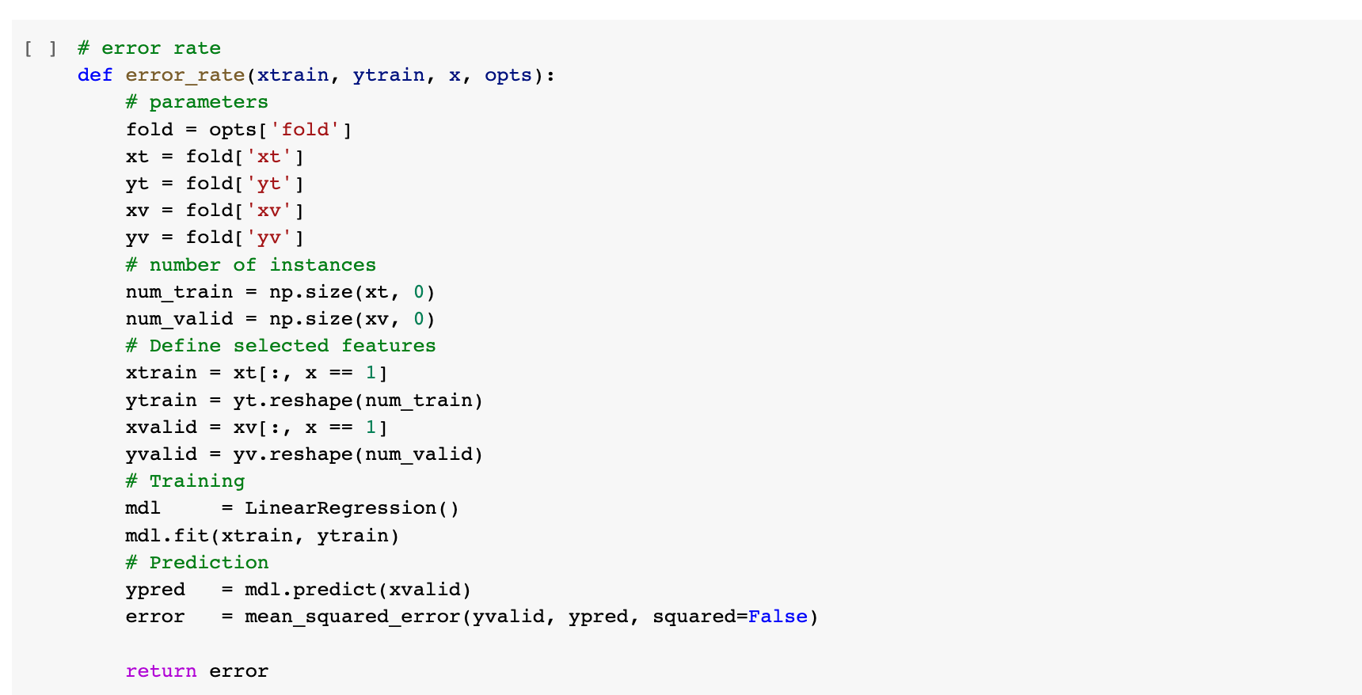
PSO - FEATURE SELECTION:
Fig 6.22 ERROR RATE FUNCTION - calculate the error of PSO

Slide 52
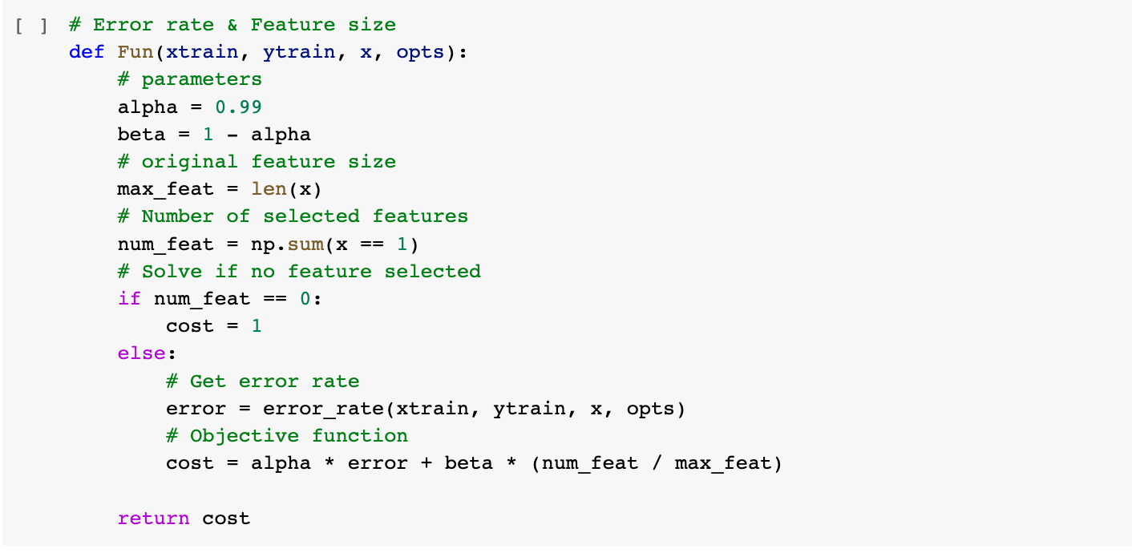
Fig 6.23 OBJECTIVE FUNCTION – calculate the cost during each iteration

Slide 53
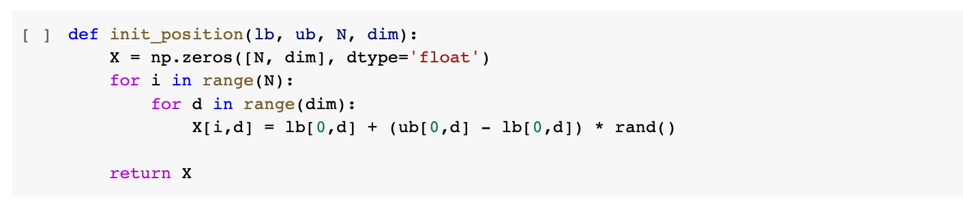
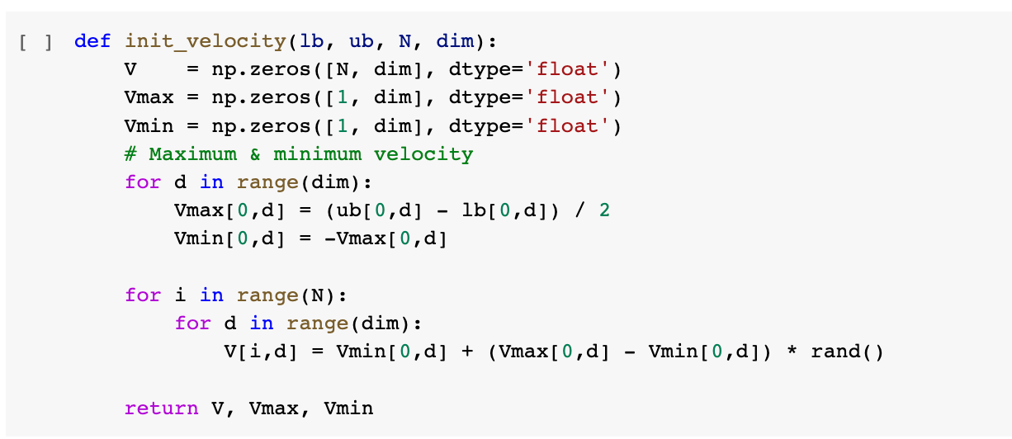
Fig 6.24 INITIAL POSITION FUNCTION – defines the position of a particle
6.25 INITIAL VELOCITY FUNCTION – defines the velocity of the particle

Slide 54
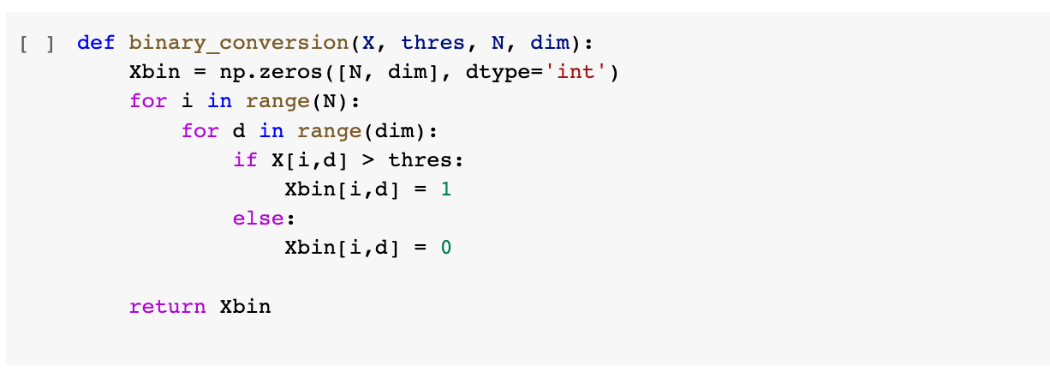
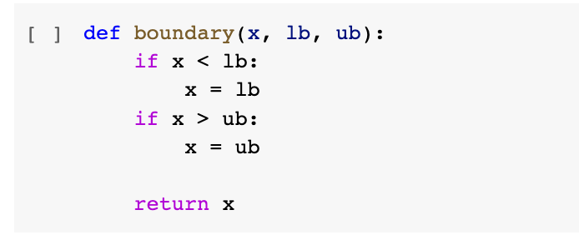
Fig 6.26 BINARY CONVERION – of value of particle
Fig 6.27 DEFINING BOUNDARIES – for particle

Slide 55
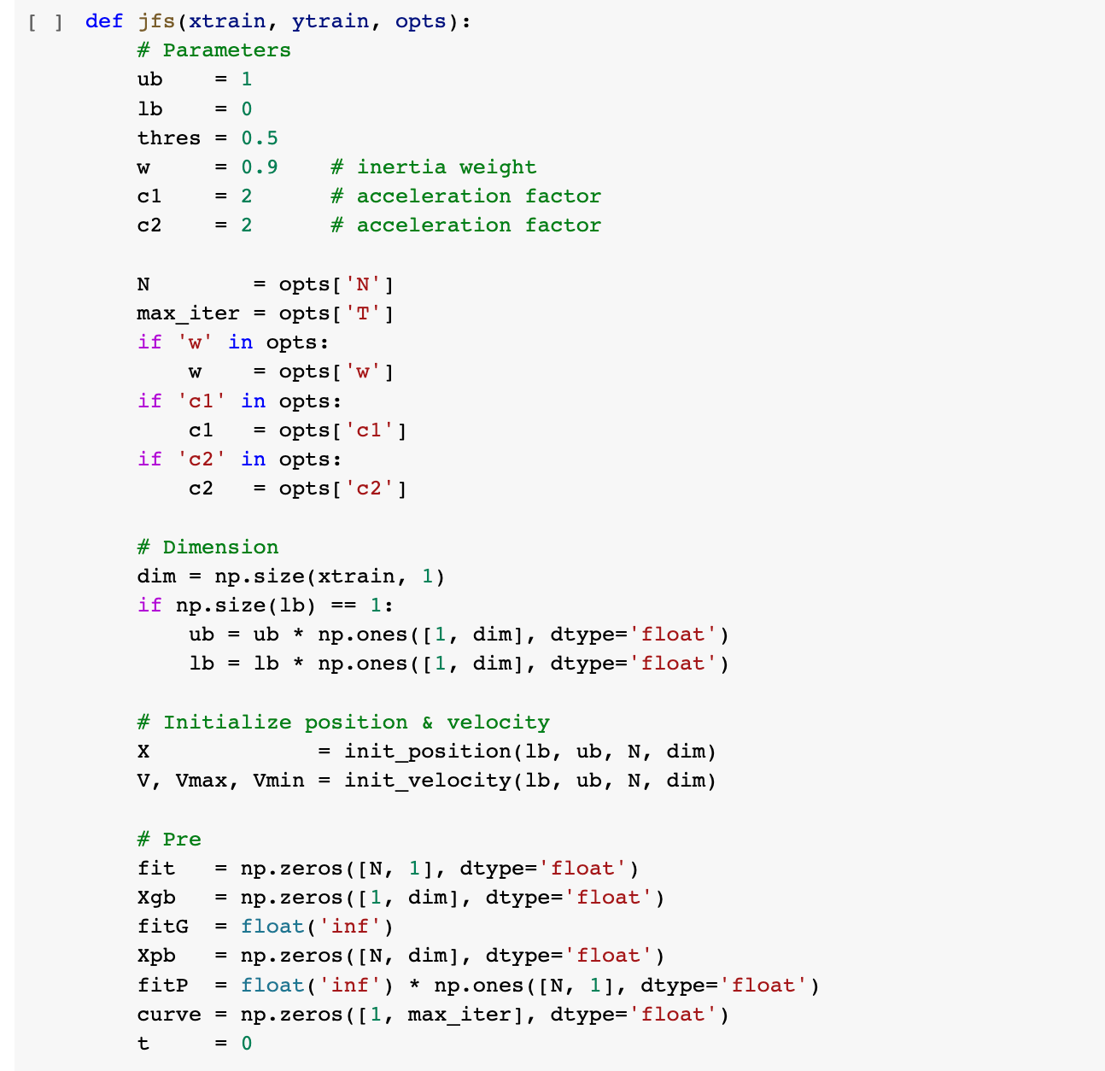
Fig 6.28 (a)

Slide 56
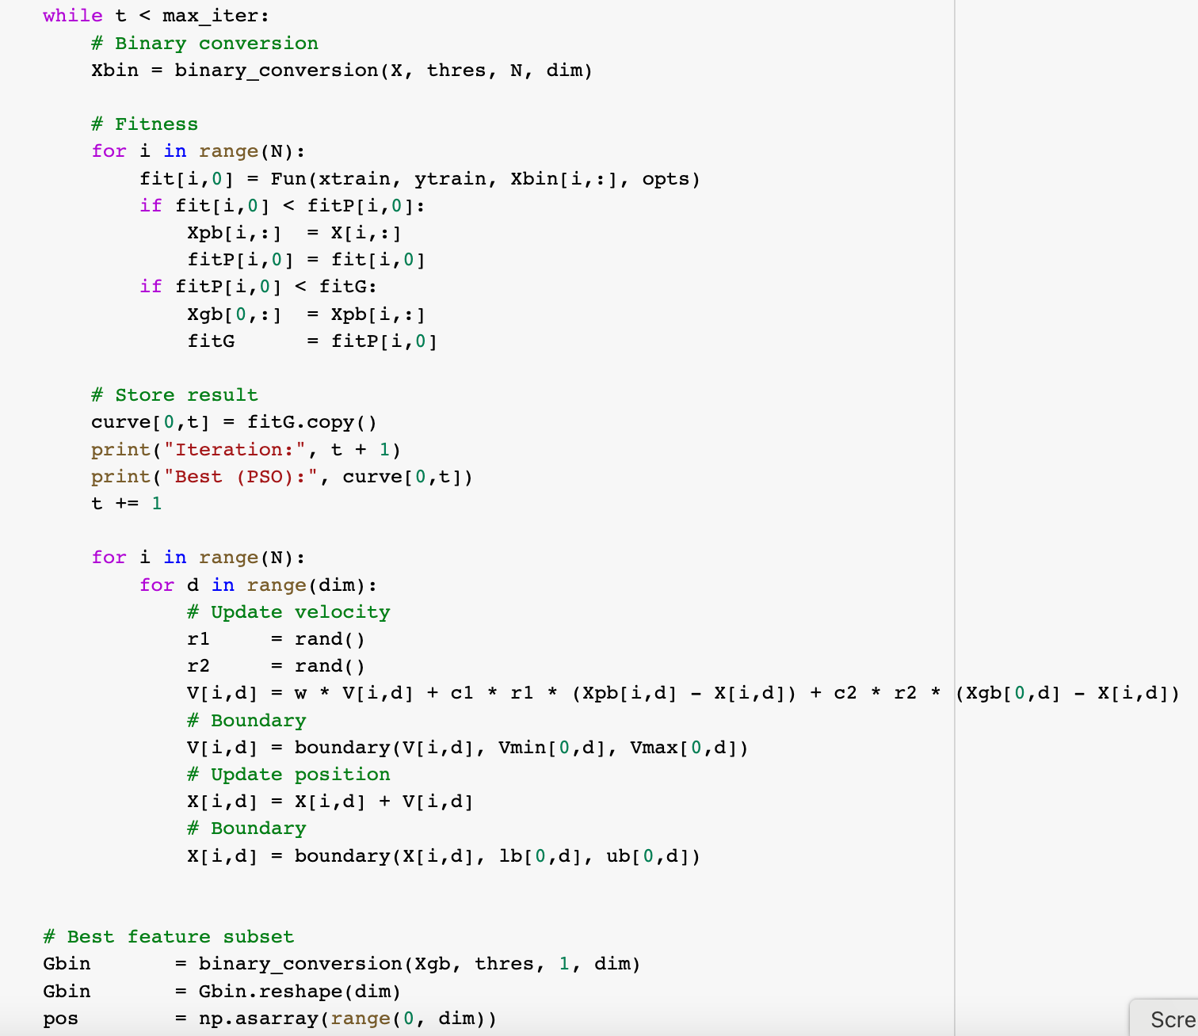

Slide 57
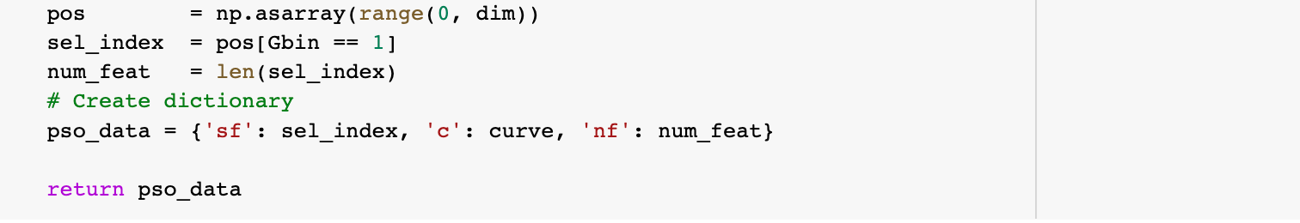
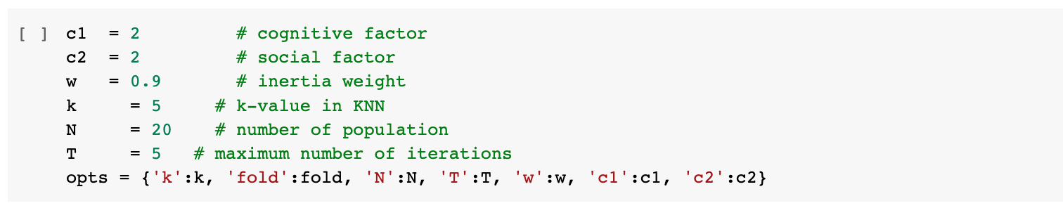
Fig 6.29(b)
Fitness function – update the initial position and initial velocity for each iteration
Fig 6.30 INITIALIZING FACTORS – constant values

Slide 58
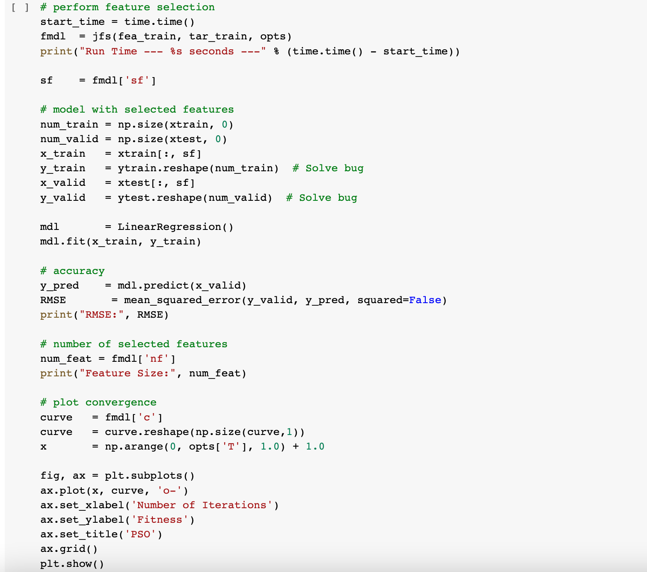
Fig 6.31 Performing feature selection and calculating RMSE for each and every iteration and storing the selected features in a variable

Slide 59
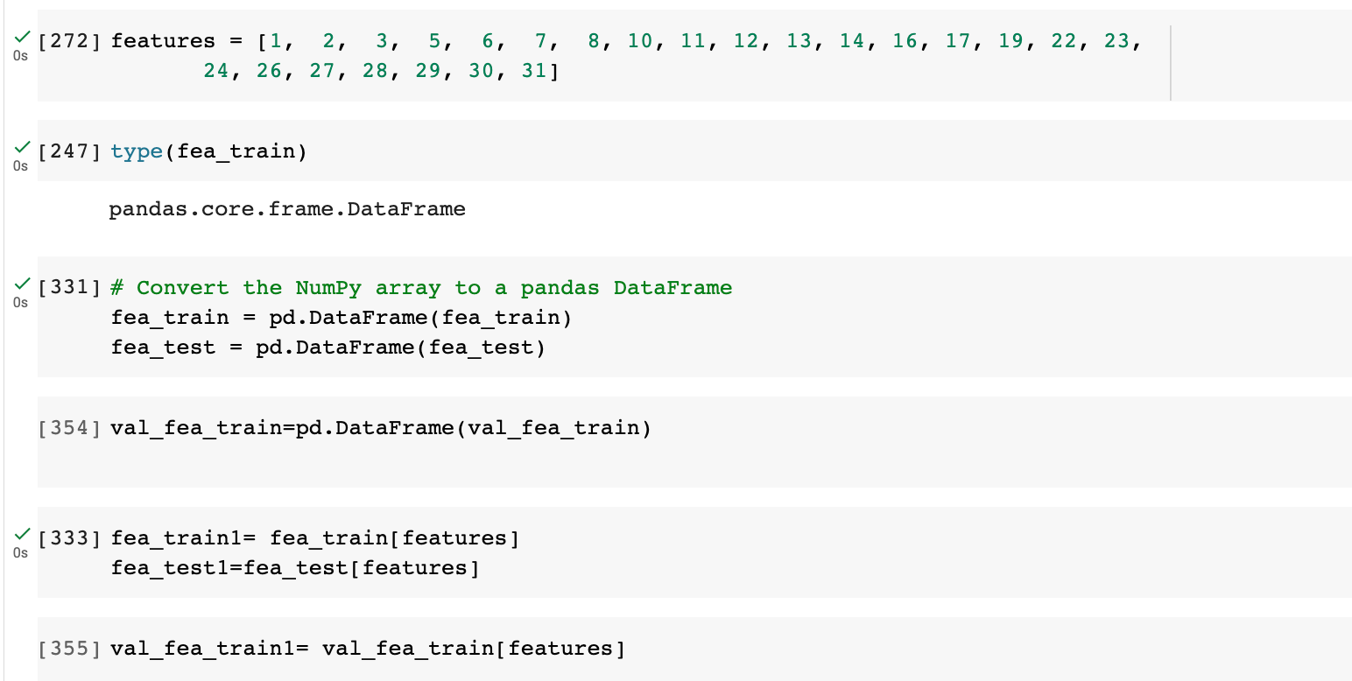
Fig 6.32 Creating the dataset with the selected features

Slide 60
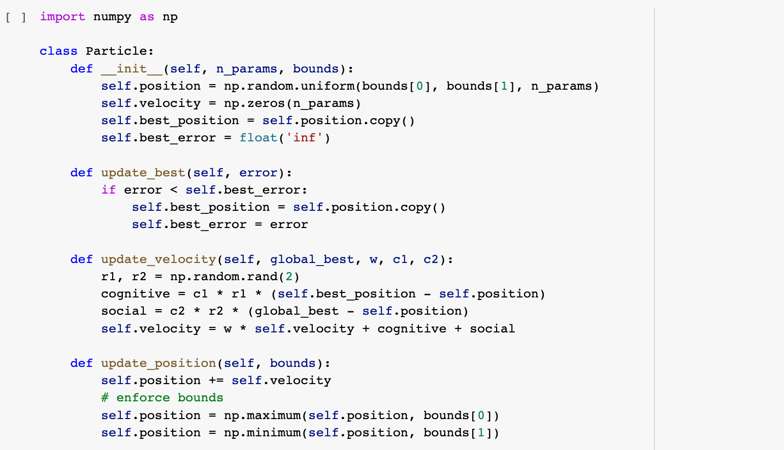
PSO - Hyper parameter selection:
Fig 6.33 Creating the particle class with position, velocity and error

Slide 61
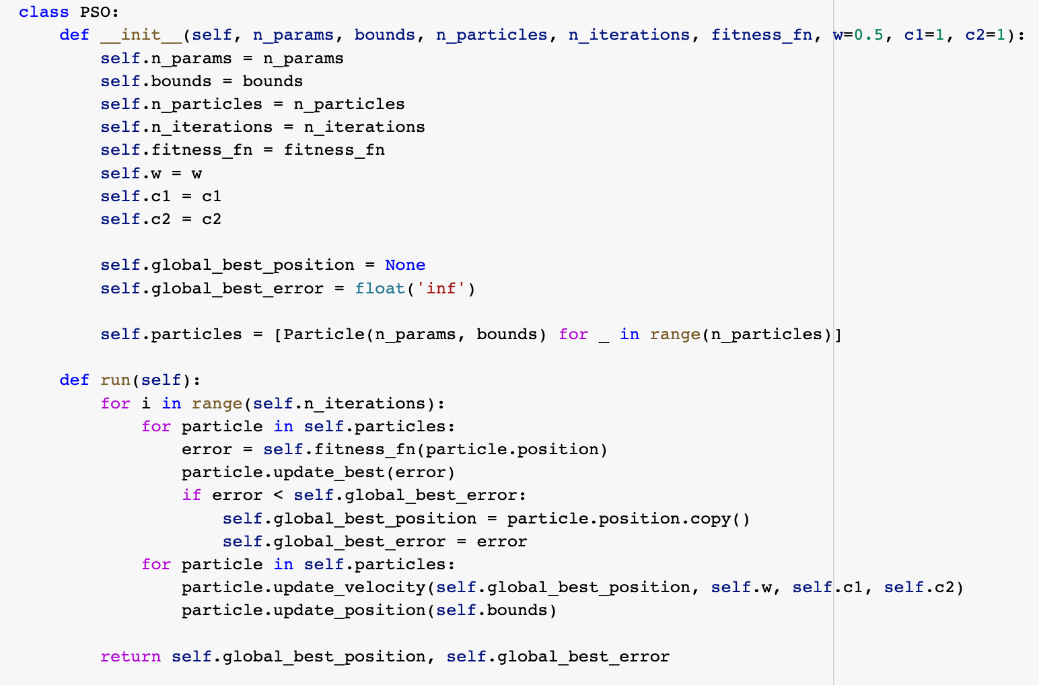
Fig 6.34 Creating the PSO class and updating for each iteration

Slide 62
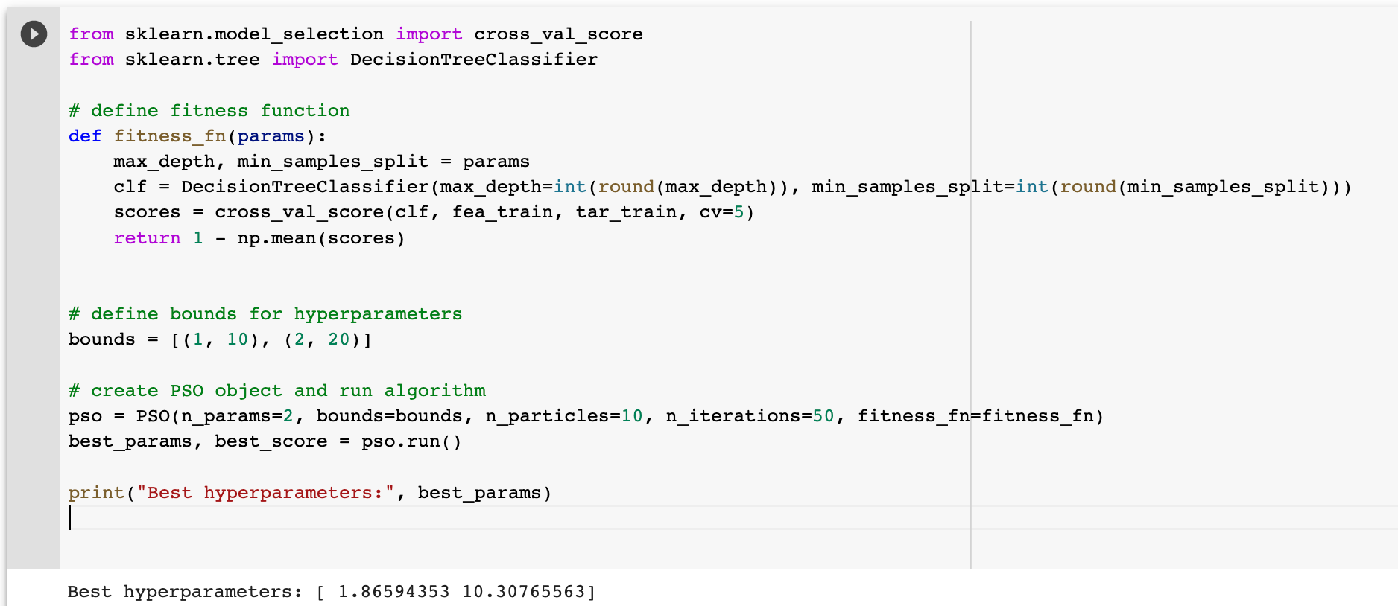
Fig 6.35 Finding the best hyper parameters

Slide 63
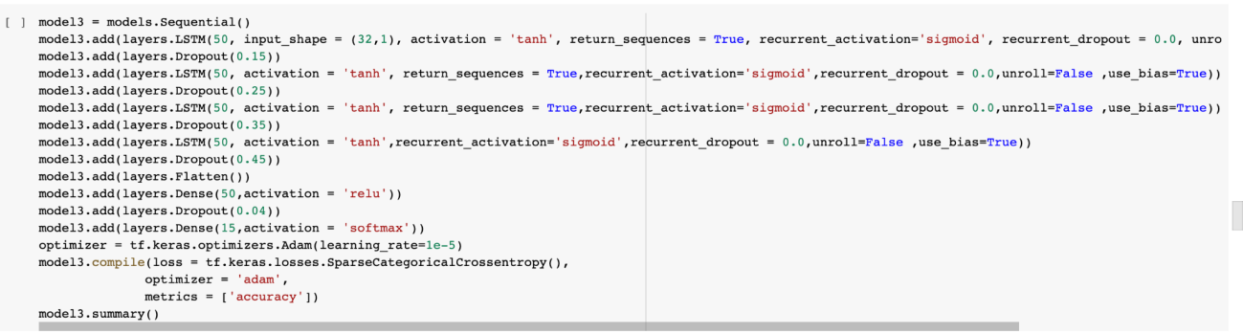
LSTM MODEL:
Fig 6.36 LSTM MODEL – Creating Layers for LSTM

Slide 64
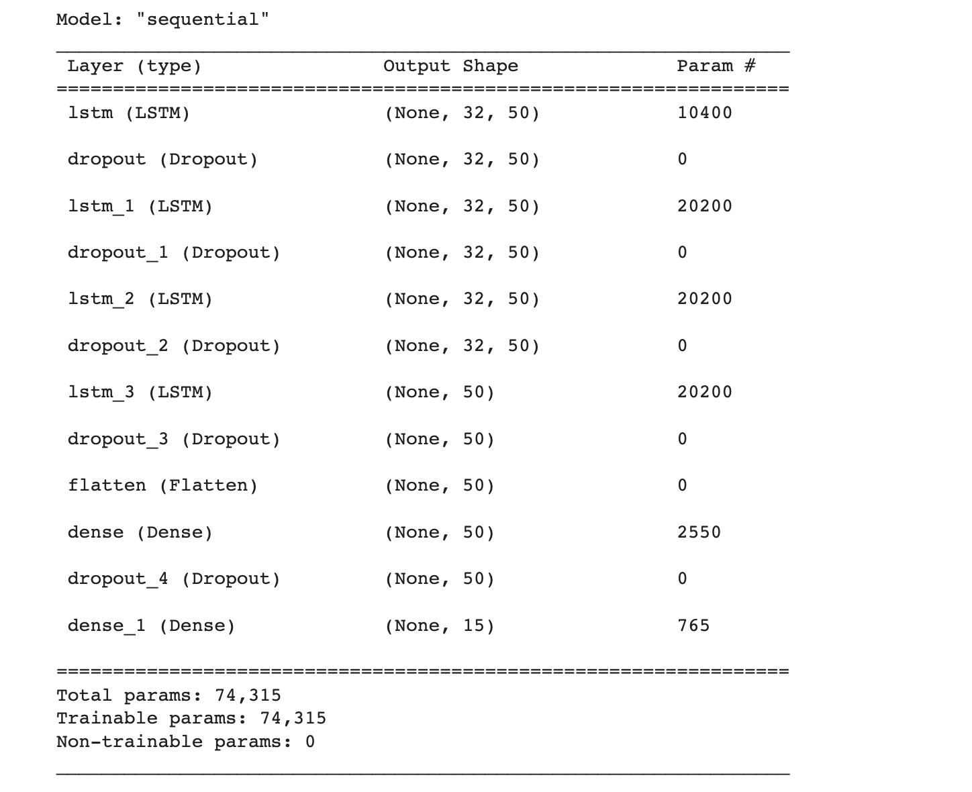
Fig 6.37 MODEL SUMMARY – shows the details of Layers

Slide 65
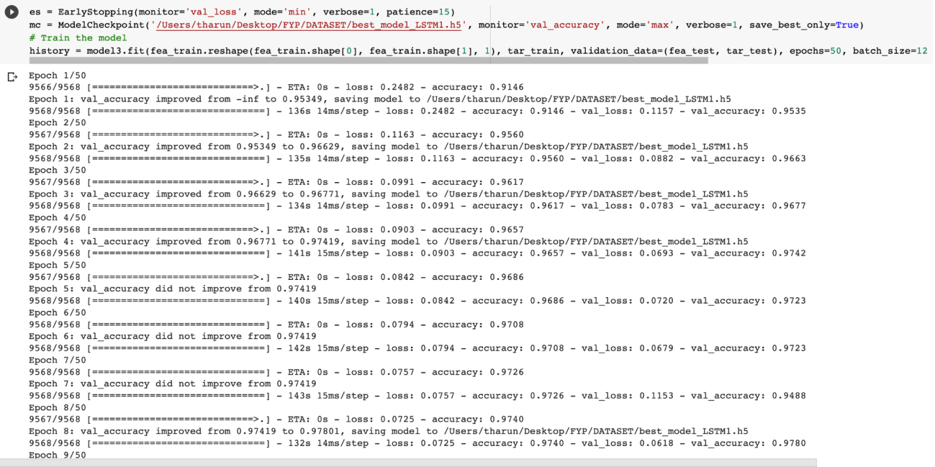

Slide 66
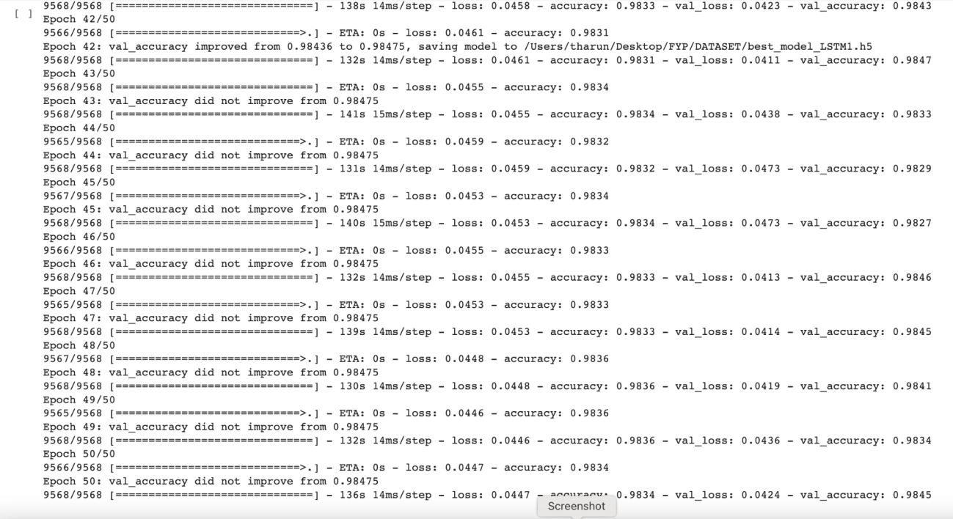
Fig 6.38 TRAINED LSTM MODEL - Shows accuracy of each epoch while training

Slide 67
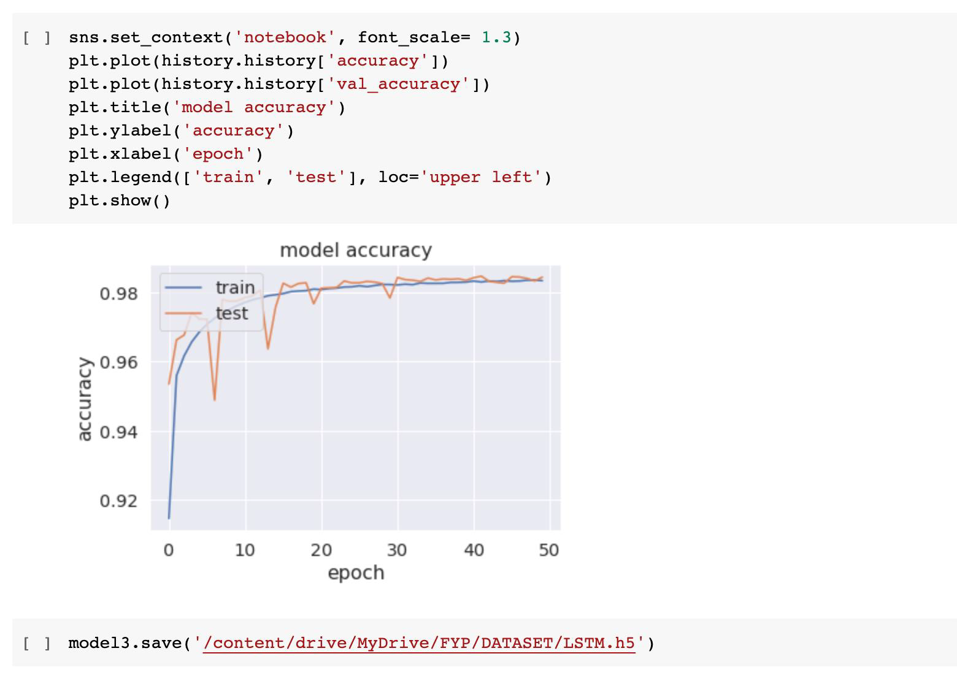
Fig 6.39 LSTM MODEL ACCURACY - the graph depicts the accuracy of epochs ranging from 0 to 50

Slide 68
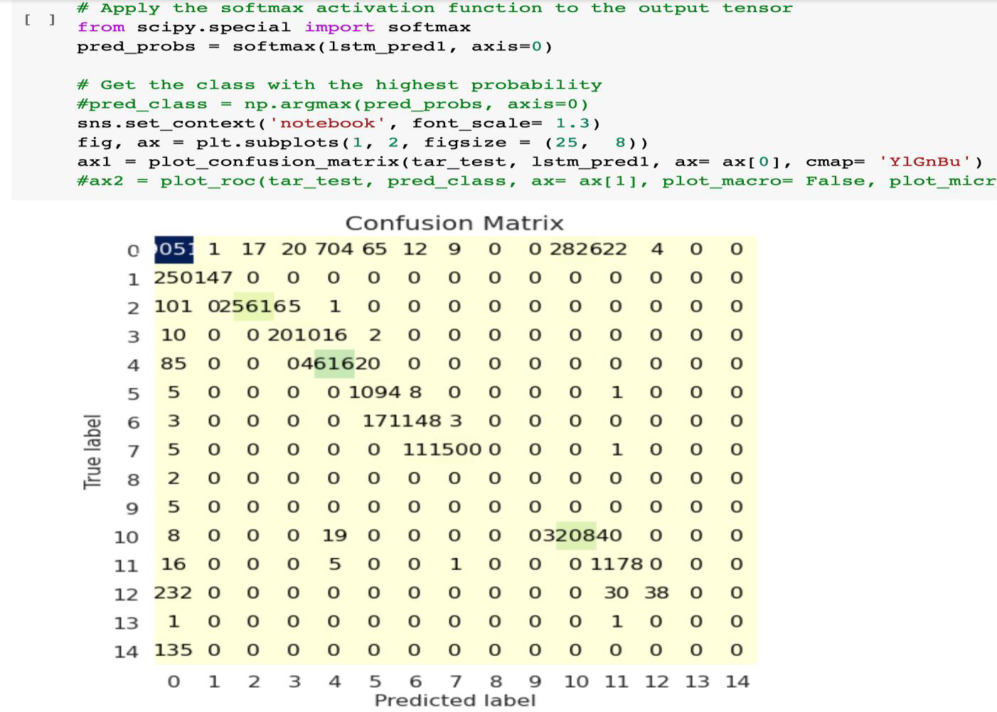
Fig 6.40 LSTM MODEL CONFUSION MATRIX

Slide 69

Fig 6.41 PRECISION AND RECALL OF LSTM MODEL

Slide 70

DECISION TREE:
Fig 6.42 PRECISION AND RECALL OF DECISION TREE MODEL – Creating decision tree model and depicting its accuracy, precision and recall

Slide 71

Fig 6.43 CONFUSION MATRIX AND ROC CURVE OF DECISION TREE MODEL

Slide 72

ENSEMBLE MODEL:
Fig 6.44 GENETIC ALGORITHM – finding best fit of weights for ensemble model

Slide 73


Fig 6.45 ACCURACY AND PREDICTION OF ENSEMBLE MODEL – Shows the best fit weight and the accuracy of the model using those weights.

Slide 74

Fig 6.46 OUTCOMES OF ENSEMBLE MODEL – Shows the predicted classes and no of instances in their respective class.

Slide 75

Fig 6.47 CONFUSION MATRIX OF ENSEMBLE MODEL

Slide 76

Fig 6.48 CLASSES IN THE DATASET

Slide 77

Fig 6.49 index function for flask app

Slide 78

Fig 6.50 CSS for the web page

Slide 79

Fig 6.51 CSS for the web page (continued)

Slide 80

Fig 6.52 HTML for the web page

Slide 81

Fig 6.53 Requirements.txt for creating docker container

Slide 82

Fig 6.54 Created docker images

Slide 83

Fig 6.55 Deployment of CSS Web app in Microsoft Azure

Slide 84

Fig 6.56 Prediction of a csv file from the Web app

Slide 85
METRICS FOR EVALUATION
THRESHOLD METRICS:
Classification Rate (CR): Classification rate is a metric that measures the accuracy of a classifier, or how well it can predict the correct class label of a data point.
Classification Rate = Number of Correct Predictions / Total Number of Predictions
F Measure (FM): F-measure is a metric used to measure the accuracy of a classification model. It is a harmonic mean between precision and recall.
F-measure = 2 * (Precision * Recall) / (Precision + Recall)

Slide 86
RANKING METRICS:
Accuracy: It is the percentage of correctly predicted labels out of all instances in the dataset.
Accuracy = (Number of Correct Predictions) / Total Number of Predictions
Recall: Recall measures the proportion of actual positive instances that are correctly identified by the model as positive.
Recall = True Positives / (True Positives + False Negatives)

Slide 87
Precision (PR): Precision is a measure of the accuracy of a measurement or a system that produces measurements.
Precision = (Number of correctly estimated measurements / Total number of measurements) x 100
Area Under ROC Curve (AUC): AUC, or Area Under the Receiver Operating Characteristic Curve, is a metric used to measure the performance of a binary classifier. It is a way to measure the accuracy and power of a classifier. AUC measures the area under the ROC curve, which is a graph of the true positive rate against the false positive rate.
AUC = ∫0,1 ROC(t)dt

Slide 88
PROBABILITY METRICS:
Root Mean Square Error (RMSE): Root Mean Square Error (RMSE) is a measure of how well a model fits a dataset. It is the average of the squared differences between the observed values and the predicted values.
RMSE = √(∑ (predicted - observed)² / n)

Slide 89
Validation data | Accuracy | Precision | Recall | F Measure
Valdata_2.csv | 0.98 | 0.9 | 0.97 | 0.99
X_val.csv | 0.75 | 0.78 | 0.75 | 0.70
Valdata_12.csv | 0.75 | 0.77 | 0.75 | 0.72
Valdata_3.csv | 0.80 | 0.81 | 0.81 | 0.80
Tb 4.1 Accuracy, Precision, Recall, F Measure of random datasets using ensemble model

Slide 90

Fig 4.1 Bar graph of Accuracies

Slide 91

Fig 4.2 Bar graph of Precision

Slide 92

Fig 4.3 Bar graph of Recall

Slide 93

Fig 4.4 Bar graph of F Measure
Fig 4.1, 4.2, 4.3, 4.4 represents bar graphs of 4 randomly picked datasets. Those datasets contain some of the attack data and normal data. Classification rate is similar to accuracy.

Slide 94

4.2 COMPARATIVE ANALYSIS
Fig 4.5 Group Bar graph of all accuracies of Decision tree, LSTM and Ensemble model

Slide 95
Fig 4.5 depicts us the information about comparison of accuracies of 3 different models for 4 different datasets. Since the decision tree has more accuracy than LSTM our weighted ensemble model takes more weight from the decision tree model and less weight from the LSTM model so that by merging these two models our Ensemble model’s accuracy is slightly more than the Decision tree.

Slide 96
4.3 ALL POSSIBLE TEST RESULTS
Ensemble Predictions | 1st Counter array
Decision Tree Predictions | 2nd Counter array
LSTM Predictions | 3rd Counter array
True Labels (Actual output) | 4th Counter array
Tb 4.2 Shows the respective info about Counter arrays for each predictions for the below diagrams

Slide 97

Fig 4.6 Shows the predictions of all 3 models and True predictions for valdata_2.csv dataset

Slide 98

Fig 4.7 Shows the predictions of all 3 models and True predictions for X_val.csv dataset

Slide 99

Fig. 4.8 Shows the predictions of all 3 models and True predictions for valdata_12.csv dataset

Slide 100

Fig. 4.9 Shows the predictions of all 3 models and the true predictions for the valdata_3.csv dataset.

Slide 101
Dataset | No of instances | No of correct predictions(ensemble model)
Valdata_2.csv | 32,768 | 31,987
X_val.csv | 2,14,304 | 1,60,775
Valdata_12.csv | 10,716 | 8,088
Valdata_3.csv | 32,768 | 26,328
Tb 4.3 shows the respective instances and no of correct predictions by ensemble model

Slide 102
CHAPTER 5
The incoming and outgoing packets of a cloud will be secured by employing this cloud intrusion detection system since we are all aware of the significance of cloud computing in modern society. However, this project is vulnerable in some aspects, such as some attacks. According to the findings, this hybrid ensemble model is neither overfit nor underfit and has an accuracy of 94%. Several datasets, both large and small, are used to validate and test this model, which is found to be accurate and stable. Consequently, the suggested method can enhance the security of transmitting and receiving packets from the cloud.
CONCLUSION AND FUTURE WORK
CONCLUSION

Slide 103
FUTURE WORK
The goal of this project's future work is to gather data on a variety of attacks, such as heartbleed, infiltration, and brute-force attacks, train the model more precisely, and enhance it with new datasets. Future work may also concentrate on creating systems that can automatically configure and monitor intrusion detection systems on cloud networks. This can lessen the administrative staff's job and concentrate on the automated adaptation of changes in the cloud environment, which improves scalability.

Slide 104
REFERENCES
[1] W. Wang, X. Du, D. Shan, R. Qin and N. Wang, "Cloud Intrusion Detection Method Based on Stacked Contractive Auto-Encoder and Support Vector Machine," in IEEE Transactions on Cloud Computing, vol. 10, no. 3, pp. 1634-1646, 1 July-Sept. 2022.
[2] A. M. Vartouni, S. S. Kashi and M. Teshnehlab, "An anomaly detection method to detect web attacks using Stacked Auto-Encoder," 2018 6th Iranian Joint Congress on Fuzzy and Intelligent Systems (CFIS), 2018, pp. 131-134.
[3] A. Javadpour, S. Kazemi Abharian and G. Wang, "Feature Selection and Intrusion Detection in Cloud Environment Based on Machine Learning Algorithms," 2017 IEEE International Symposium on Parallel and Distributed Processing with Applications and 2017 IEEE International Conference on Ubiquitous Computing and Communications (ISPA/IUCC), Guangzhou, China, 2017, pp. 1417-1421F
[4] G. Kene and D. P. Theng, "A review on intrusion detection techniques for cloud computing and security challenges," 2015 2nd International Conference on Electronics and Communication Systems (ICECS), Coimbatore, India, 2015, pp. 227-232

Slide 105
[5] M. Ficco, L. Tasquier and R. Aversa, "Intrusion Detection in Cloud Computing," 2013 Eighth International Conference on P2P, Parallel, Grid, Cloud and Internet Computing, Compiegne, France, 2013, pp. 276-283
[6] U. Oktay and O. K. Sahingoz, "Proxy Network Intrusion Detection System for cloud computing," 2013 The International Conference on Technological Advances in Electrical, Electronics and Computer Engineering (TAEECE), Konya, Turkey, 2013, pp. 98-104
[7] H. A. Kholidy and F. Baiardi, "CIDS: A Framework for Intrusion Detection in Cloud Systems," 2012 Ninth International Conference on Information Technology - New Generations, Las Vegas, NV, USA, 2012, pp. 379-385
[8] A. Kannan, G. Q. Maguire Jr., A. Sharma and P. Schoo, "Genetic Algorithm Based Feature Selection Algorithm for Effective Intrusion Detection in Cloud Networks," 2012 IEEE 12th International Conference on Data Mining Workshops, 2012, pp. 416-423.

Slide 106
[9] F. I. Shiri, B. Shanmugam and N. B. Idris, "A parallel technique for improving the performance of signature-based network intrusion detection system," 2011 IEEE 3rd International Conference on Communication Software and Networks, 2011, pp. 692-696.
[10] C. -C. Lo, C. -C. Huang and J. Ku, "A Cooperative Intrusion Detection System Framework for Cloud Computing Networks," 2010 39th International Conference on Parallel Processing Workshops, San Diego, CA, USA, 2010, pp. 280-284

